Slide 1
Module 14: Natural Language Processing

Slide 2
Neural Language Models
Jurafsky and Martin Chapters 7 and 9

Slide 3
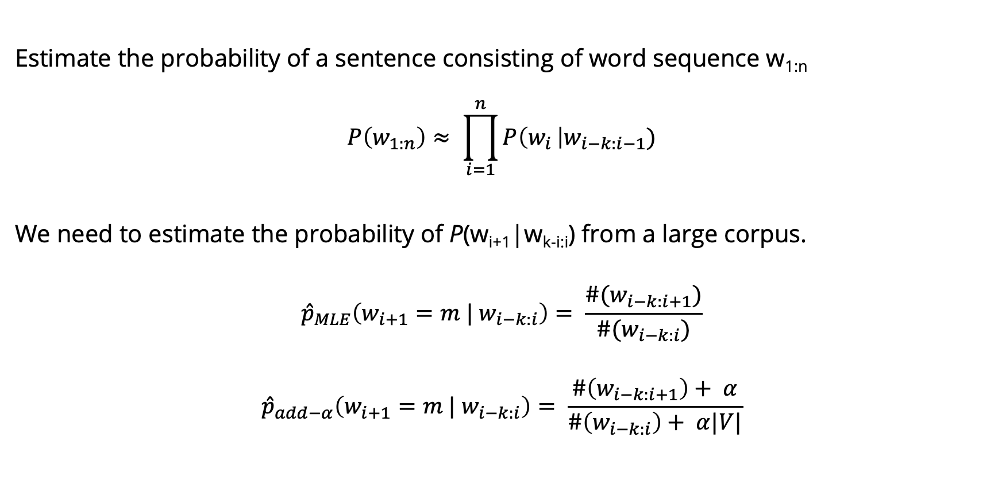
Language Models
Estimate the probability of a sentence consisting of word sequence w_{1:n}
$$P\left(w_{1:n}\right)≈ \prod_{i=1}^{n}{P\left(w_{i }\right|w_{i−k:i−1})}$$
We need to estimate the probability of P(w_{i+1}|w_{k-i:i}) from a large corpus.
$${\hat{p}}_{MLE}\left(w_{i+1}=m | w_{i−k:i}\right)= \frac{\#(w_{i−k:i+1})}{\#(w_{i−k:i})}$$
$${\hat{p}}_{add−α}\left(w_{i+1}=m | w_{i−k:i}\right)= \frac{\#\left(w_{i−k:i+1}\right)+ α}{\#\left(w_{i−k:i}\right)+ α|V|}$$

Slide 4
Language Modeling
Goal: Learn a function that returns the joint probability
Primary difficulty:
There are too many parameters to accurately estimate. This is sometimes called the “curse of dimensionality”
In n-gram-based models we fail to generalize to related words / word sequences that we have observed.

Slide 5
Curse of dimensionality / sparse statistics
Suppose we want a joint distribution over 10 words. Suppose we have a vocabulary of size 100,000.
100,000¹⁰ =10⁵⁰ parameters
This is too high to estimate from data.

Slide 6
Chain rule
In LMs we user chain rule to get the conditional probability of the next word in the sequence given all of the previous words:
$P(w_{1}w_{2}w_{3}$…$w_{t})= \prod_{t=1}^{T}{P(w_{t}|}w_{1}$…$w_{t−1})$
What assumption do we make in n-gram LMs to simplify this?
The probability of the next word only depends on the previous n-1 words.
A small n makes it easier for us to get an estimate of the probability from data.

Slide 7
Probability tables
We construct tables to look up the probability of seeing a word given a history.
The tables only store observed sequences.
What happens when we have a new (unseen) combination of n words?
curse of | P(w_{t} | w_{t-n} … w_{t-1})
dimensionality
azure
knowledge
oak
Notes:
“Stupid” multinomial distributions == table lookup.

Slide 8
Unseen sequences
What happens when we have a new (unseen) combination of n words?
Back-off
Smoothing / interpolation
We are basically just stitching together short sequences of observed words.

Slide 9
Alternate idea
Let’s try generalizing.
Intuition: Take a sentence like
The cat is walking in the bedroom
And use it when we assign probabilities to similar sentences like
The dog is running around the room
Notes:
Draw vectors under the words.
Write out: sim(cat, dog)

Slide 10
Neural Language Models
Neural Language models have several advantages over n-gram LMs:
1. They don’t need smoothing
2. They can handle much longer histories.
3. They can generalize over contexts of similar words.
4. Neural LMs tend to have much higher predictive accuracy than n-gram LMs.
Disadvantage: slower to train than traditional n-gram LMs

Slide 11
Neural LMs
In neural LMs, the prior context is represented by embeddings. This allows neural LMs to generalize better than n-gram LMs.
Imagine in training we have seen
I have to make sure when I get home to feed the cat.
But we’ve never seen “feed the dog” in training. If in the test set, we want to predict the next word after
I forgot when I got home to feed the ____
An n-gram LM will only predict cat, but a neural LM will know that the embeddings for cat and dog are similar.
Notes:
In neural language models, the prior context is represented by embeddings of the previous words. Representing the prior context as embeddings, rather than by ex- act words as used in n-gram language models, allows neural language models to generalize to unseen data much better than n-gram language models. For example, suppose we’ve seen this sentence in training:
Take an input and time t, represent some number of previous words (w_{t-1}, w_{t-2,} w_{t-3}), and output a probability distribution over the next word. P(w_{t} | w_{t-1}, w_{t-2,} w_{t-3}).

Slide 12
Neural LMs (Bengio et al 2003)
Associate each word in the vocabulary with a vector-representation, thereby creating a notion of similarity between words.
Express the joint probability function of a word sequence in terms of the word vectors for the words in that sequence.
Simultaneously learn the word vectors and the parameters of the function.
The word vectors are low-dimensional (d=30 to d=100) dense vectors, like we’ve seen before.
The probability function is expressed the product of conditional probabilities of the next word given the previous word, using a multi-layer, feed forward neural network.

Slide 13
Neural LMs
The input to the neural network is a k-gram of words w_{1:k}.
The output is a probability distribution over the next word.
The k context words are treated as a word window. Each word is associated with an embedding vector:
The input vector x just concatenates v(w) for each of the k words:

Slide 14
Neural LMs
The input x is fed into a neural network with 1 or more hidden layers:
Notes:
V is a finite vocabulary, including the unique symbols U for unknown words, <s> for sentence initial padding, and </s> for end-of-sequence marking. e vocabulary size, jV j, ranges between 10,000–1,000,000 words, with the common sizes revolving around 70,000.

Slide 16
Training
The training examples are simply word k-grams from the corpus
The identities of the first k+1 words are used as features, and the last word is used as the target label for the classification.
Conceptually, the model is trained using cross-entropy loss.
Working with cross entropy loss works very well, but requires the use of a costly softmax operation which can be prohibitive for very large vocabularies, we we often use alternative loss functions or approximations.
Notes:
Large output spaces Working with neural probabilistic language models with large output spaces (i.e., efficiently computing the softmax over the vocabulary) can be prohibitive both at training time and at test time. Dealing with large output spaces efficiently is an active research question. Some of the existing solutions are as follows.
Hierarchical softmax [Morin and Bengio, 2005] allows to compute the probability of a single word in O.log jV j/ time rather than O.jV j/. is is achieved by structuring the softmax computation as tree traversal, and the probability of each word as the product of branch selection decisions. Assuming one is interested in the probability of a single word (rather than getting the distribution over all words) this approach provides clear benefits in both training and testing time. Self-normalizing aproaches, such as noise-contrastive estimation (NCE) [Mnih and Teh, 2012, Vaswani et al., 2013] or adding normalizing term to the training objective [Devlin et al., 2014]. e NCE approach improves training time performance by replacing the cross-entropy objective with a collection of binary classification problems, requiring the evaluation of the assigned scores for k random words rather than the entire vocabulary. It also improves test-time prediction by pushing the model toward producing “approximately normalized” exponentiated scores, making the model score for a word a good substitute for its probability. e normalization term approach of Devlin et al. [2014] similarly improves test time efficiency by adding a term to the training objective that encourages the exponentiated model scores to sum to one, making the explicit summation at test time unnecessary (the approach does not improve training time efficiency). Sampling Approaches approximate the training-time softmax over a smaller subset of the vocabu- lary [Jean et al., 2015].
A good review and comparison of these and other techniques for dealing with large output vocabularies is available in Chen et al. [2016].
An orthogonal line of work is attempting to sidestep the problem by working at the char- acters level rather than words level.

Slide 17
Training
The training examples are simply word k-grams from the corpus
The identities of the first k-1 words are used as features, and the last word is used as the target label for the classification.
Conceptually, the model is trained using cross-entropy loss.
Notes:
Large output spaces Working with neural probabilistic language models with large output spaces (i.e., efficiently computing the softmax over the vocabulary) can be prohibitive both at training time and at test time. Dealing with large output spaces efficiently is an active research question. Some of the existing solutions are as follows.
Hierarchical softmax [Morin and Bengio, 2005] allows to compute the probability of a single word in O.log jV j/ time rather than O.jV j/. is is achieved by structuring the softmax computation as tree traversal, and the probability of each word as the product of branch selection decisions. Assuming one is interested in the probability of a single word (rather than getting the distribution over all words) this approach provides clear benefits in both training and testing time. Self-normalizing aproaches, such as noise-contrastive estimation (NCE) [Mnih and Teh, 2012, Vaswani et al., 2013] or adding normalizing term to the training objective [Devlin et al., 2014]. e NCE approach improves training time performance by replacing the cross-entropy objective with a collection of binary classification problems, requiring the evaluation of the assigned scores for k random words rather than the entire vocabulary. It also improves test-time prediction by pushing the model toward producing “approximately normalized” exponentiated scores, making the model score for a word a good substitute for its probability. e normalization term approach of Devlin et al. [2014] similarly improves test time efficiency by adding a term to the training objective that encourages the exponentiated model scores to sum to one, making the explicit summation at test time unnecessary (the approach does not improve training time efficiency). Sampling Approaches approximate the training-time softmax over a smaller subset of the vocabu- lary [Jean et al., 2015].
A good review and comparison of these and other techniques for dealing with large output vocabularies is available in Chen et al. [2016].
An orthogonal line of work is attempting to sidestep the problem by working at the char- acters level rather than words level.

Slide 18
Advantages of NN LMs
Better results. They achieve better preplexity scores than SOTA n-gram LMs.
Larger N. NN LMs can scale to much larger orders of n. This is achievable because parameters are associated only with individual words, and not with n-grams.
They generalize across contexts. For example, by observing that the words blue, green, red, black, etc. appear in similar contexts, the model will be able to assign a reasonable score to the green car even though it never observed in training, because it did observe blue car and red car.
A by-product of training are word embeddings
Notes:
Language models can be trained on raw text: for training a k-order language model one just needs to extract .k C 1/grams from running text, and treat the .k C 1/th word as the supervision signal. us, we can generate practically unlimited training data for them.

Slide 19
A Neural Probabilistic LM
Bengio et al NIPS 2003
Use a vector space model where the words are vectors with real values ℝ^{m}. m=30, 60, 100. This gives a way to compute word similarity.
Define a function that returns a joint probability of words in a sequence based on a sequence of these vectors.
Simultaneously learn the word representations and the probability function from data.
Seeing one of the cat/dog sentences allows them to increase the probability for that sentence and its combinatorial # of “neighbor” sentences in vector space.

Slide 20
A Neural Probabilistic LM
Given:
A training set w₁ … w_{t} where w_{t} ∈V
Learn:
f(w₁ … w_{t}) = P(w_{t}|w₁ … w_{t-1})
Subject to giving a high probability to an unseen text/dev set (e.g. minimizing the perplexity)
Constraint:
Create a proper probability distribution (e.g. sums to 1) so that we can take the product of conditional probabilities to get the joint probability of a sentence

Slide 21
A Neural Probabilistic LM
Create a mapping function C from any word in V onto ℝ^{M}. Store this in a V-by-M matrix. Initialize it with singular value decomposition (SVD).
The neural architecture: a function g maps sequence of word vectors onto a probability distribution over the vocabulary V
g(C(w_{t-n}) … C(w_{t-1})) = P(w_{t}|w_{t-n} … w_{t-1})
Notes:
g is implemented with a feed forward or recurrent neural network, trained with stochastic gradient descent. Softmax is used in the output layer.

Slide 22
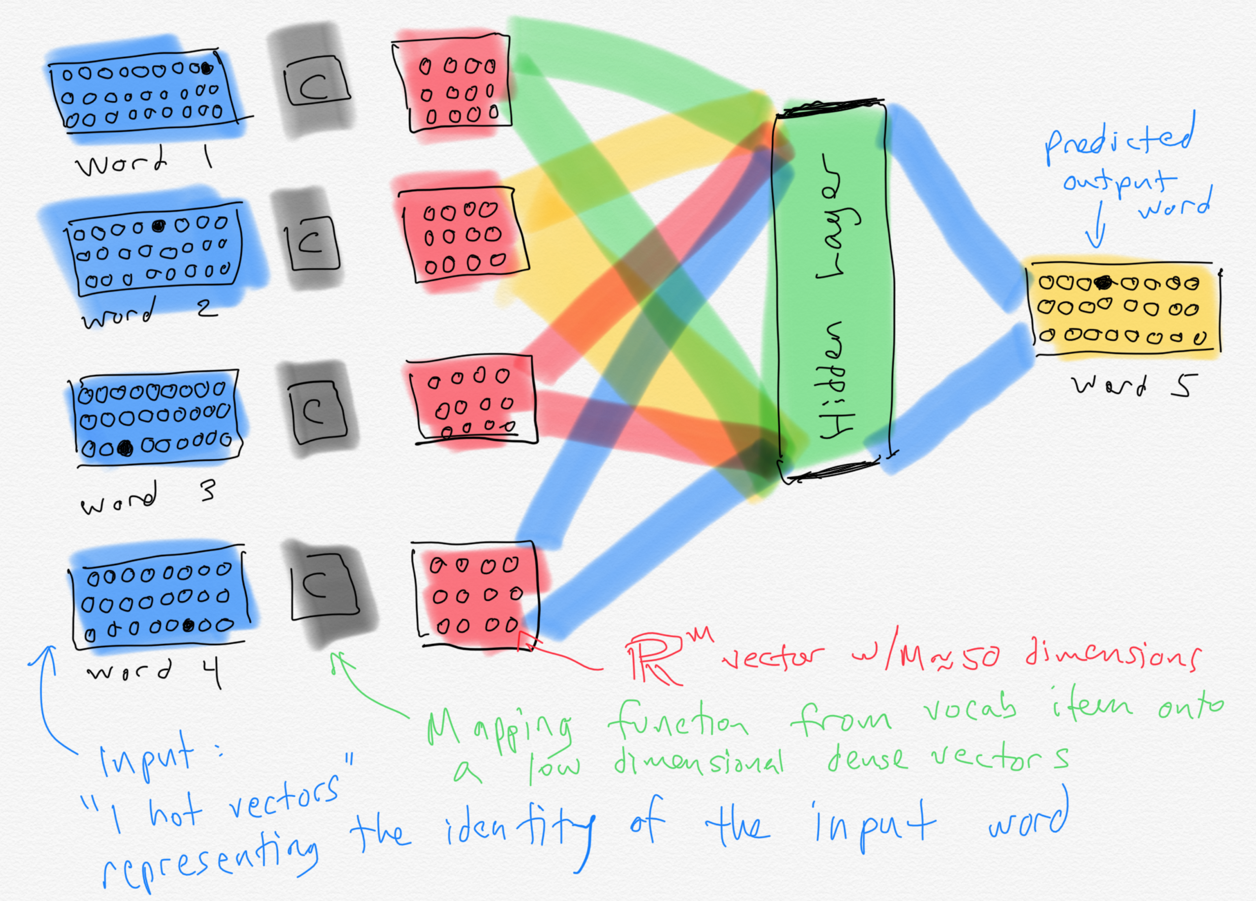

Slide 23
Word embeddings
When the ~50 dimensional vectors that result from training a neural LM are projected down to 2-dimensions, we see a lot of words that are intuitively similar to each other are close together.
Notes:
A by-product of training neural network-based language models are dense word embeddings, similar to word2vec.

Slide 24
State of the art neural LMs
ELMo
GPT
BERT
GPT-3
Notes:
ELMo: Embeddings from Language Models
GPT: Improving Language Understanding by Generative PreTraining
BERT: Bidirectional Encoder Representations from Transformers.

Slide 25
NLP: Vector Semantics
Jurafsky and Martin Chapter 6

Slide 26
Word Meaning
How should we represent the meaning of a word?
In N-gram LMs we represented words as a string of letters or as an index in a vocabulary list.
Ideally, we want a meaning representation to encode:
Synonyms – words that have similar meanings
Antonyms – words that have opposite meanings
Connotations – words that are positive or negative
Semantic Roles – buy, sell, and pay are different parts of the same underlying purchasing event
Support for entailment
Notes:
(If I buy something from you, you’ve probably sold it to me, and I likely paid you).

Slide 27
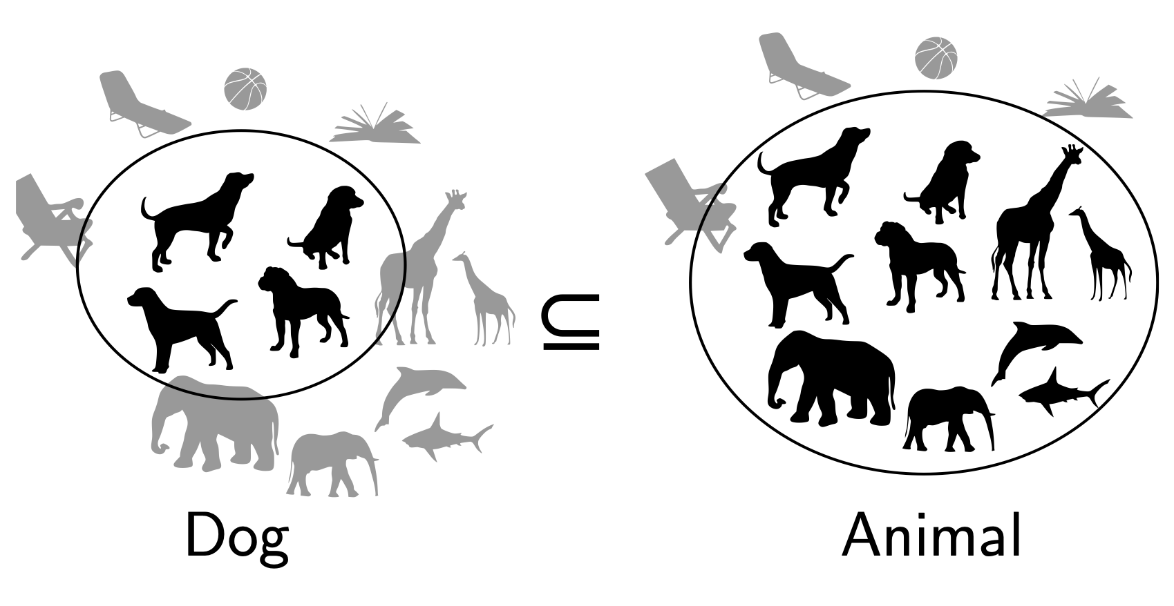
Entailment in formal semantics

Slide 28
Entailment in formal semantics
All animals have an ulnar artery
⇒
All dogs have an ulnar artery
+ Mathematically well-understood + Powerful machinery for handling logical operations
- Knowledge must come from somewhere else

Slide 29
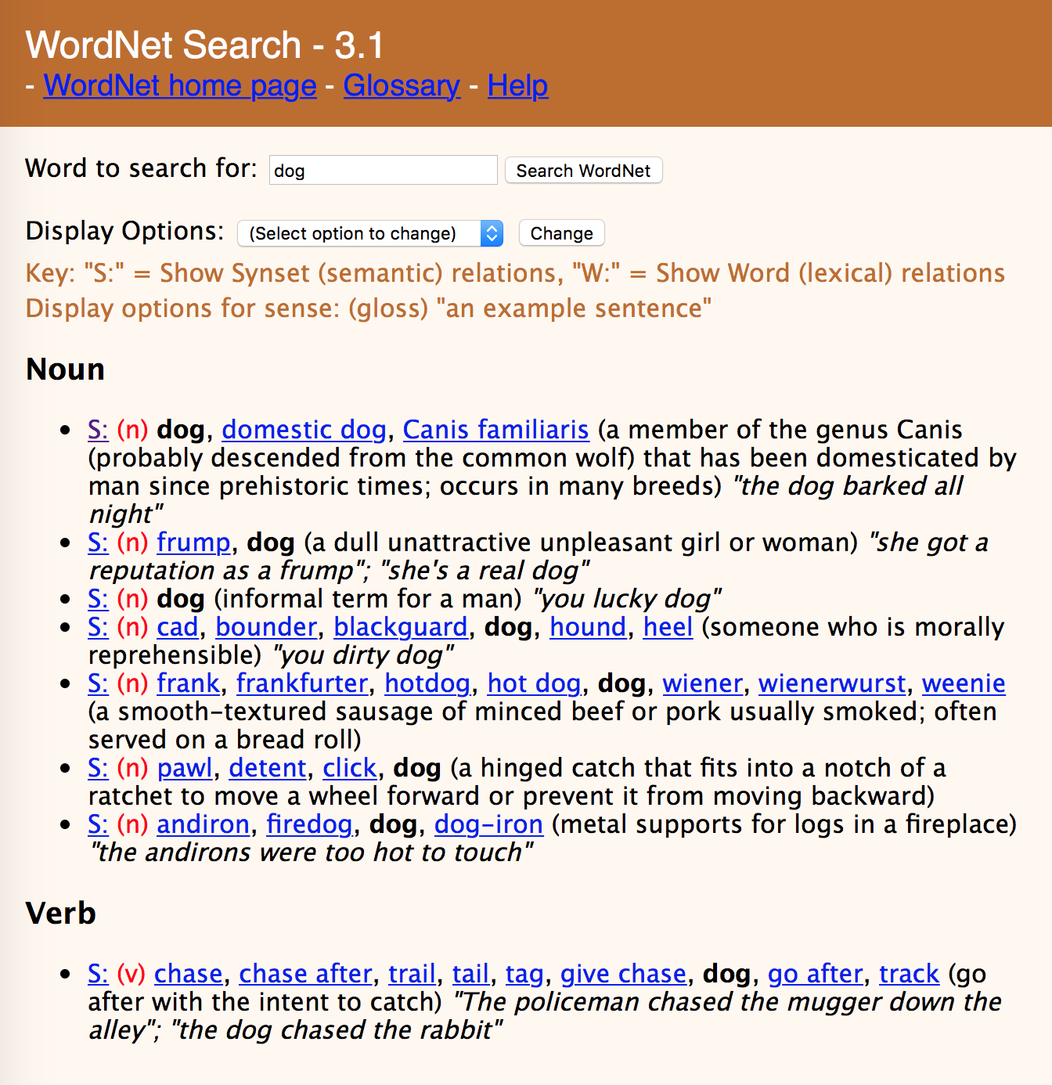

Slide 32
Lexical Semantics
act
communicate
perform
address
relay
practice
harangue
talk about
walk through
scrimmage
rant
descant
WordNet

Slide 33
Lexical Semantics
act
communicate
perform
address
relay
practice
harangue
talk about
walk through
scrimmage
rant
descant
WordNet
Vector Space Models
Notes:
VSMs have several attractive properties. VSMs extract knowledge automatically from a given corpus, thus they require much less labour than other approaches to semantics, such as hand-coded knowledge bases and ontologies.

Slide 34
Vector Space Models
Notes:
The idea of the VSM is to represent each word as a point in a space (a vector in a vector space). Points that are close together in this space are semantically similar and points that are far apart are semantically distant.

Slide 35
Dictionary Definitions
Noun
A small insect.
A harmful microorganism, as a bacterium or virus.
An enthusiastic, almost obsessive, interest in something. ‘they caught the sailing bug’
A miniature microphone, typically concealed in a room or telephone, used for surveillance.
An error in a computer program or system.
Verb
Conceal a miniature microphone in (a room or telephone) in order to monitor or record someone's conversations.
Annoy or bother (someone)
Notes:
Here the form bug is the lemma, also called the citation form. The form bug would also be the lemma for the word bugs; dictionaries don’t have separate definitions for inflected forms. Similarly sing is the lemma for sing, sang, sung. In many languages the infinitive form is used as the lemma for the verb, so Spanish dormir “to sleep” is the lemma for duermes “you sleep”. The specific forms sung or carpets or sing or duermes are called wordforms.

Slide 36
Polysemy
A word that has multiple meanings is called polysemous. We call each of these aspects of the meaning of bug a word sense.
Polysemy can make interpretation difficult.
What if someone types “caught a bug” into Google?
Word sense disambiguation is the task of determining which sense of a word is being used in a context.

Slide 37
Synonymy
When one word has a sense whose meaning is nearly identical to a sense of another word then those two words are synonyms.
glitch/error
microbe/bacterium
insect/pest
microphone/wire
Formally, two words are synonymous if they are substitutable one for the other in any sentence without changing the truth conditions of the sentence.
In logic, that means the two words carry the same propositional meaning.
Notes:
That means that all the situations in which the original sentence would be true, the sentence with the substitution would also be true.

Slide 38
Principle of Contrast
Linguists assume that a difference in form is always associated with a difference in meaning.
While substitutions like water/H₂O or father/dad are truth preserving, the words are still not identical in meaning.
H₂O is used in scientific contexts, but not general texts like hiking guides
Father is a more formal version of dad.
It is possible that no two words have absolutely identical meaning.

Slide 39
Word similarity
Most words don’t have many synonyms, but they do have a lot of similar words. Cat is not a synonym of dog, but cats and dogs are certainly similar words.
“fast” is similar to “rapid”
“tall” is similar to “height”
Useful for applications like question answering
Notes:
In moving from synonymy to similarity, it will be useful to shift from talking about relations between word senses (like synonymy) to relations between words (like similarity). Dealing with words avoids having to commit to a particular representation of word senses, which will turn out to simplify our task.

Slide 40
Word similarity
Most words don’t have many synonyms, but they do have a lot of similar words. Cat is not a synonym of dog, but cats and dogs are certainly similar words.
“fast” is similar to “rapid”
“tall” is similar to “height”
Useful for applications like Question Answering
Notes:
In moving from synonymy to similarity, it will be useful to shift from talking about relations between word senses (like synonymy) to relations between words (like similarity). Dealing with words avoids having to commit to a particular representation of word senses, which will turn out to simplify our task.

Slide 41
Word similarity
Can similar words be substituted in any sentence without changing its truth conditions? No.
How can we measure whether words are similar? One way is to ask humans to judge how similar one word is to another.
Word 1 | Word 2 | Similarity Score
Vanish | Disappear | 9.8
Tiger | Cat | 7.4
Love | Sex | 6.8
Muscle | Bone | 3.6
Cucumber | Professor | 0.3
Notes:
SimLex-999 dataset (Hill et al., 2015) gives values on a scale from 0 to 10, like the examples below, which range from near-synonyms (vanish, disappear) to pairs that scarcely seem to have anything in common (hole, agreement):

Slide 42
Word Relatedness
Words can still be related in ways other than being similar to each other.
Coffee and Cup are not similar because they don’t share any features
coffee is a plant or a beverage,
cup is a manufactured object made in a useful shape
But they’re related by co-participating in the same event.
Relatedness is measured with word association tests in psychology.
A semantic field is a set of words which cover a semantic domain and bear structured relations with each other.
Hospitals: surgeon, scalpel, nurse, anesthetic, hospital Restaurants: waiter, menu, plate, food, chef Houses: family, door, roof, kitchen, bed

Slide 43
Semantic Roles
An event like a commercial transaction described with different verbs
buy (the event from the perspective of the buyer),
sell (from the perspective of the seller),
pay (focusing on the monetary aspect),
Or with nouns like buyer.
Frames encode semantic roles (like buyer, seller, goods, money), and the words in a sentence that take on these roles.
Notes:
Closely related to semantic fields is the idea of a semantic frame. A semantic frame is a set of words that denote perspectives or participants in a particular type of event.
Knowing that buy and sell have this relation makes it possible for a system to know that a sentence like Sam bought the book from Ling could be paraphrased as Ling sold the book to Sam, and that Sam has the role of the buyer in the frame and Ling the seller. Being able to recognize such paraphrases is important for question answering, and can help in shifting perspective for machine translation.

Slide 44
Connotation
Words have affective meanings or connotations. Three important dimensions of affective meaning.
Valence – the pleasantness of the stimulus
Arousal – the intensity of emotion provoked by the stimulus
Dominance – the degree of control exerted by the stimulus
 | Valence | Arousal | Dominance
courageous | 8.05 | 5.5 | 7.38
music | 7.67 | 5.57 | 6.5
heartbreak | 2.45 | 5.65 | 3.58
cub | 6.71 | 3.95 | 4.24
life | 6.68 | 5.59 | 5.89

Slide 45
Points in space
Osgood et al. (1957) noticed that in using these 3 numbers to represent the meaning of a word, the model was representing each word as a point in a three-dimensional space
Part of the meaning of heartbreak can be represented as a vector with three dimensions corresponded to the word’s rating on the three scales.
heartbreak | 2.45 | 5.65 | 3.58

Slide 46
Vector Space Models
Notes:
The idea of the VSM is to represent each word as a point in a space (a vector in a vector space). Points that are close together in this space are semantically similar and points that are far apart are semantically distant.

Slide 47
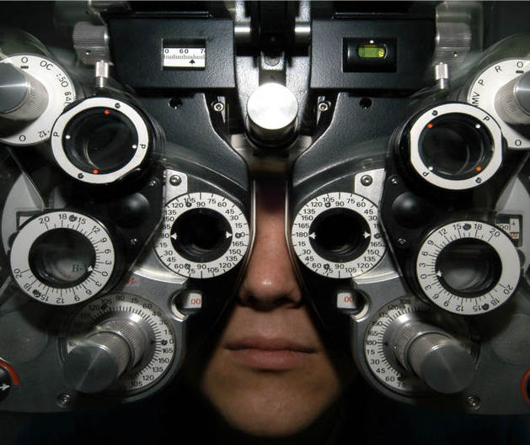
Distributional Hypothesis
If we consider optometrist and eye-doctor we find that, as our corpus of utterances grows, these two occur in almost the same environments. In contrast, there are many sentence environments in which optometrist occurs but lawyer does not...
It is a question of the relative frequency of such environments, and of what we will obtain if we ask an informant to substitute any word he wishes for optometrist (not asking what words have the same meaning).
These and similar tests all measure the probability of particular environments occurring with particular elements... If A and B have almost identical environments we say that they are synonyms.
–Zellig Harris (1954)
Notes:
Similar messages expressed by Wittgenstein (1953) and Firth (1957) who said “You shall know a word by the company it keeps.”
VSMs are interesting especially due to their relation with the distributional hypothesis and related hypotheses. The distributional hypothesis is that words that occur in similar contexts tend to have similar meanings. Efforts to apply this abstract hypothesis to concrete algorithms for measuring the similarity of meaning often lead to vectors, matrices, and higher-order tensors.

Slide 48
Intuition of distributional word similarity
Nida (1975) example: A bottle of tesgüino is on the table Everybody likes tesgüino Tesgüino makes you drunk We make tesgüino out of corn.
From context words humans can guess tesgüino means an alcoholic beverage like beer
Intuition for algorithm: Two words are similar if they have similar word contexts.

Slide 49
History of Vector Space Models
Vector Space Models were initially developed in the SMART information retrieval system (Salton, 1971)
Each document in a collection is represented as point in a space (a vector in a vector space)
A user’s query is a pseudo-document and is represented as a point in the same space as the documents
Perform IR by retrieving documents whose vectors are close together in this space to the query vector

Slide 50
Term-Document Matrix
 | D1 | D2 | D3 | D4 | D5
abandon
abdicate
abhor
academic
…
zygodactyl
zymurgy
Notes:
Documents can be things like Shakespeare’s plays, or novels, or web pages

Slide 51


Term-Document Matrix
 | D1 | D2 | D3 | D4 | D5
abandon
abdicate
abhor
academic
…
zygodactyl
zymurgy
Each column vector
represents a Document
Notes:
Documents can be things like Shakespeare’s plays, or Wikipedia pages, or IMDB reviews for a movie.

Slide 52
Term-Document Matrix
 | D1 | D2 | D3 | D4 | D5
abandon
abdicate
abhor
academic
…
zygodactyl
zymurgy
Each row vector
represents a Term

Slide 53


Term-Document Matrix
 | D1 | D2 | D3 | D4 | D5
abandon
abdicate
abhor
academic
…
zygodactyl
zymurgy
The value in a cell is
based on how often that term
occurred in that document

Slide 54

Term-Document Matrix
}
 | D1 | D2 | D3 | D4 | D5
abandon
abdicate
abhor
academic
…
zygodactyl
zymurgy
The length of the
document vectors
is the size of the vocabulary

Slide 55
Term-Document Matrix
 | D1 | D2 | D3 | D4 | D5
abandon
abdicate
abhor
academic
…
zygodactyl
zymurgy
Document vectors
can be sparse
(most values are 0)

Slide 56

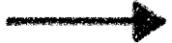
Term-Document Matrix
 | D1 | D2 | D3 | D4 | D5
abandon
abdicate
abhor
academic
…
zygodactyl
zymurgy
We can measure
how similar two
documents are
by comparing their
column vectors

Slide 57
What can document similarity let you do?

Slide 58
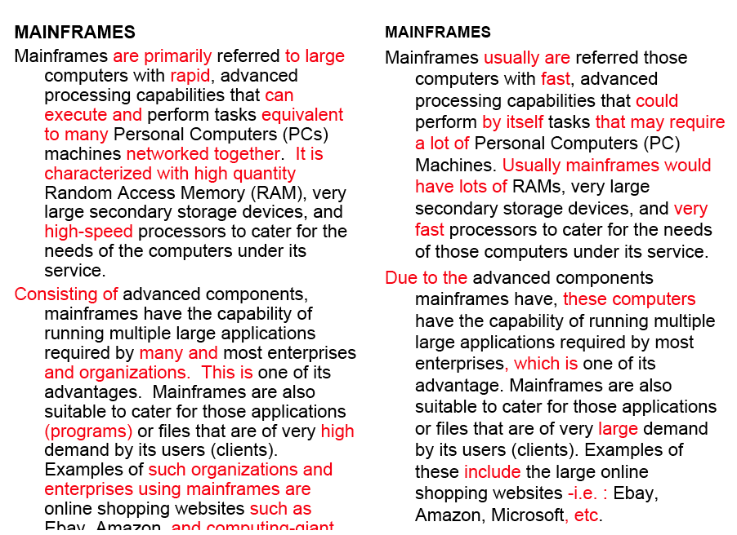
Word similarity for plagiarism detection

Slide 59
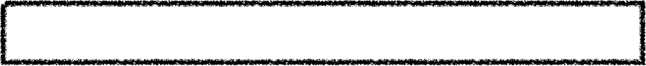

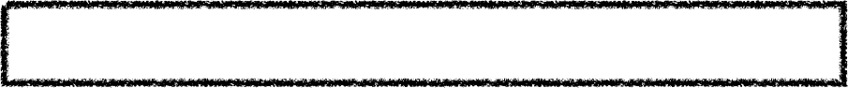
Term-Document Matrix
 | D1 | D2 | D3 | D4 | D5
abandon
abdicate
abhor
academic
…
zygodactyl
zymurgy
What does comparing
two row vectors do?
Notes:
It measures the similarity between words!

Slide 60
Vector comparisons
 | docX | docY
A | 2 | 4
B | 10 | 15
C | 14 | 10
Notes:
docY is a positive movie review
docx is a less positive movie review
A = "superb" positive / low frequency
B = "good" positive / high frequency
C = "disappointing" negative / high frequency

Slide 61
Vector comparisons
 | docX | docY
A | 2 | 4
B | 10 | 15
C | 14 | 10
docY is a positive movie review
docx is a less positive movie review
A = "superb" positive / low frequency
B = "good" positive / high frequency
C = "disappointing" negative / high frequency
Notes:
docY is a positive movie review
docx is a less positive movie review
A = "superb" positive / low frequency
B = "good" positive / high frequency
C = "disappointing" negative / high frequency

Slide 62
Vector comparisons
 | docX | docY
A | 2 | 4
B | 10 | 15
C | 14 | 10
doc Y
Notes:
Euclidean distance : vectors u, v of dimension N
sqrt (sum_i to N ( | ui - vi|² ) )
A to B is sqrt of | 2-10 |² + | 4-15 |² = 13.6
B to C is sqrt of | 10-14 |² + | 15-10 |² = 6.4
A = Superb, B = Good, C=Disappointing
Goal: related words are close, and unrelated words are far apart.
Did we do it?

Slide 63
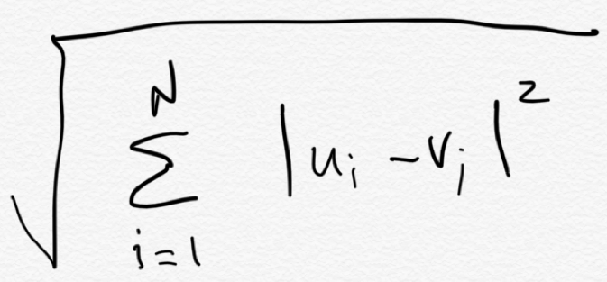
Vector comparisons
Euclidean distance
 | docX | docY
A | 2 | 4
B | 10 | 15
C | 14 | 10
B
distance = 6.4
distance = 13.6
C
Euclidean distance : vectors u, v of dimension N
A

Slide 64
Vector comparisons
Oh no! Good is
closer to Disappointing
than to Superb.
Euclidean distance
 | docX | docY
A | 2 | 4
B | 10 | 15
C | 14 | 10
B = Good
distance = 6.4
distance = 13.6
C = Disappointing
Euclidean distance : vectors u, v of dimension N
A = Superb

Slide 65
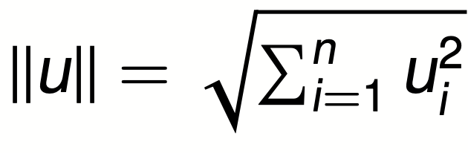
Vector L2 (length) Normalization
 | docX | docY
A | 2 | 4
B | 10 | 15
C | 14 | 10
||u||
4.47
18.02
17.20

Slide 66
Vector L2 (length) Normalization
 | docX | docY
A | 2/4.47 | 4/4.47
B | 10/18.02 | 15/18.02
C | 14/17.2 | 10/17.2
||u||
4.47
18.02
17.20
Divide each vector by its L2 length

Slide 67
Vector comparisons
 | docX | docY
A | 2 | 4
B | 10 | 15
C | 14 | 10
Notes:
Euclidean distance : vectors u, v of dimension N
sqrt (sum_i to N ( | ui - vi|² ) )
A to B is sqrt of | 2-10 |² + | 4-15 |² = 13.6
B to C is sqrt of | 10-14 |² + | 15-10 |² = 6.4
A = Superb, B = Good, C=Disappointing
Goal: related words are close, and unrelated words are far apart.
Did we do it?

Slide 68
Vector L2 (length) Normalization
 | docX | docY
Ȧ | 0.45 | 0.89
Ḃ | 0.55 | 0.83
Ċ | 0.81 | 0.58
A = Superb
B = Good
C = Disappointing
Now Good is
closer to Superb
than to Disappointing

Slide 69
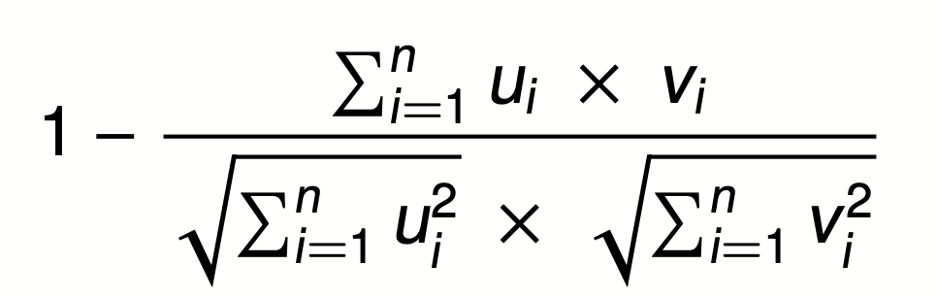

Cosine Distance
A = Superb
B = Good
C = Disappointing
Cosine does the L2
normalization too
Cosine angle between
vectors tells us their similarity

Slide 70
Term-Term Matrix
 | abandon | abdicate | abhor | … | zymurgy
abandon
abdicate
abhor
academic
…
zygodactyl
zymurgy
Notes:
Defines a co-occurrence matrix
w-2, w-1 target word w+1 w+2

Slide 71
Term-Term Matrix
AKA Term-Context Matrix
 | abandon | abdicate | abhor | … | zymurgy
abandon
abdicate
abhor
academic
…
zygodactyl
zymurgy
Length of the vector is now |V|
instead of number of documents
Notes:
|V| = size of vocabulary

Slide 72
Term-Term Matrix
AKA Term-Context Matrix
 | abandon | abdicate | abhor | … | zymurgy
abandon
abdicate
abhor
academic
…
zygodactyl
zymurgy
The value in a cell indicates how
often abandon appears in a
context window surrounding
abdicate
Notes:
Defines a co-occurrence matrix
w-2, w-1 target word w+1 w+2

Slide 73
Context windows
w-2, w-1 target_word w+1 w+2
The government most not abdicate responsibility to non-elected
it has led men to abdicate their family responsibilities
other demands, but declining to abdicate his responsibility
leaders abdicate their role and present people with no plans
 | his | leaders | not | responsibility | to
abdicate | 1 | 1 | 1 | 2 | 3
Notes:
Defines a co-occurrence matrix
w-2, w-1 target word w+1 w+2

Slide 74
Context windows
Occur in a window of +/- 2 words, in the same sentence, in the same document
Instead of window of words use more complex contexts: dependency patters. Subj-of-verb, adj-mod, obj-of-verb
Languages have long distance dependencies The pictures are beautiful. The pictures of the old man are beautiful. The pictures of the old man holding his grandchild are beautiful.
Notes:
Defines a co-occurrence matrix
w-2, w-1 target word w+1 w+2

Slide 75
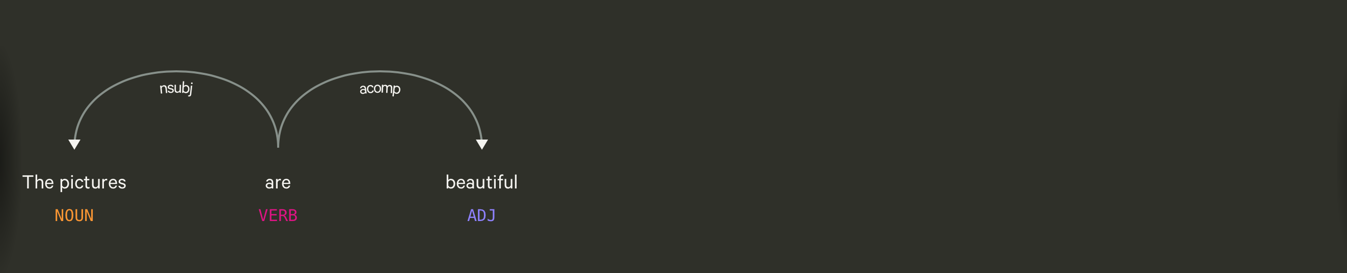
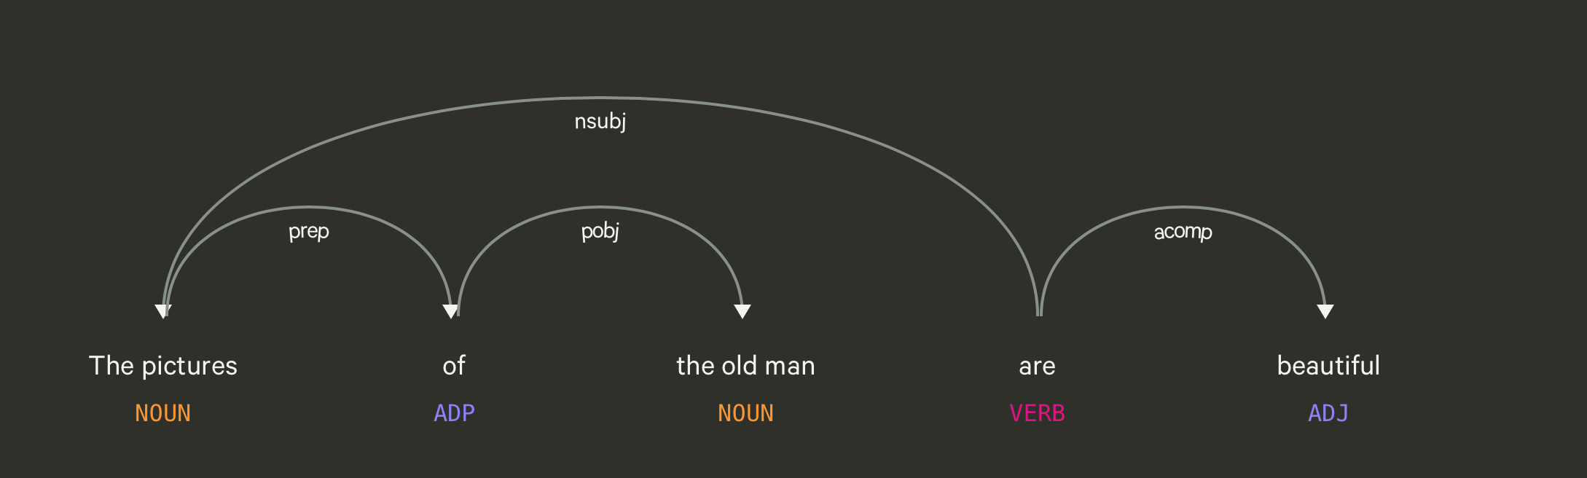
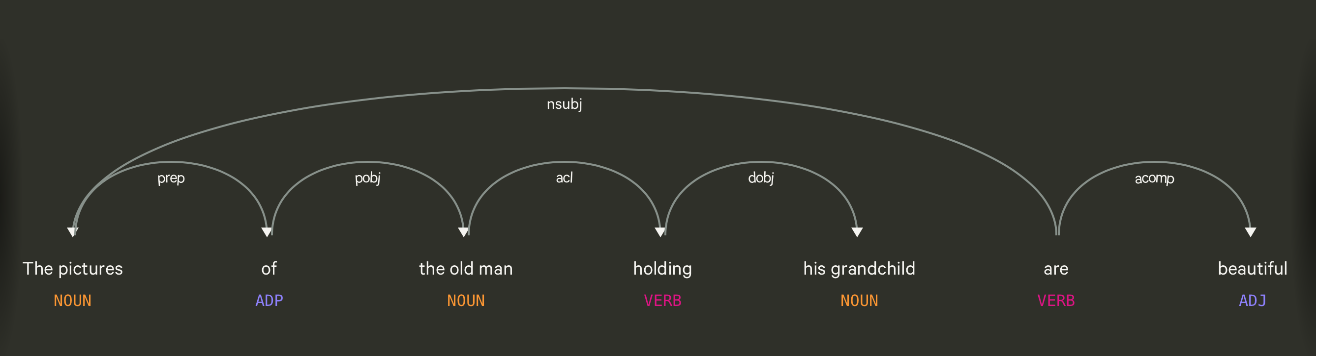

Slide 76
Using syntax to define a word’s context
Zellig Harris (1968) “The meaning of entities, and the meaning of grammatical relations among them, is related to the restriction of combinations of these entities relative to other entities”
Duty and Responsibility have similar syntactic distributions
Modified by adjectives | additional, administrative, assumed, collective, congressional, constitutional …
Object of verbs | assert, assign, assume, attend to, avoid, become, breach..

Slide 77
Alternates to counts
Raw word frequency is not a great measure of association between words. It’s very skewed “the” and “of” are very frequent, but maybe not the most discriminative
We’d rather have a measure that asks whether a context word is particularly informative about the target word.
Instead of raw counts, it’s common to transform vectors using TF-IDF or PPMI
Notes:
I’m going to skip the definition of PPMI for this talk

Slide 78
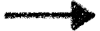

TF-IDF
Term frequency * inverse document frequency
How often a
word occurred in
a document
1 over the number
of documents that it
occurred in
Notes:
What does this do to a word like the?

Slide 79
Sparse v. Dense Vectors
Co-occurrence matrix (weighted by TF-IDF or mutual information)
Long (length |V| = 50,000+)
Sparse (most elements are zeros)
Alternative: learn vectors that are
Short (length 200-1000)
Dense (most elements are non-zero)
Notes:
ccb - future todo - Re-work as a visual?

Slide 80
Neural Language Models

Slide 81
Word Embeddings
Jurafsky and Martin Chapters 7 and 9

Slide 82
Word embeddings
Word embeddings were a by-product of training the Neural LM. When the ~50 dimensional vectors are projected down to 2-dimensions, we see a lot of words that are intuitively similar to each other are close together.
Notes:
A by-product of training neural network-based language models are dense word embeddings, similar to word2vec.

Slide 83
Sparse versus Dense Vectors
Co-occurrence matrix (weighted by TF-IDF or mutual information)
long (length |V|= 20,000 to 50,000)
sparse (most elements are zero)
Embeddings are
short (length 50-1000)
dense (most elements are non-zero)

Slide 84
Sparse versus dense vectors
Why dense vectors?
Short vectors may be easier to use as features in machine learning (fewer weights to tune)
Dense vectors may generalize better than storing explicit counts
They may do better at capturing synonymy:
car and automobile are synonyms; but are distinct dimensions in sparse vectors
a word with car as a neighbor and a word with automobile as a neighbor should be similar, but aren't
In practice, they work better

Slide 85

Dense embeddings you can download!
Word2vec (Mikolov et al.)
https://code.google.com/archive/p/word2vec/
Fasttext http://www.fasttext.cc/
Glove (Pennington, Socher, Manning)
http://nlp.stanford.edu/projects/glove/
Magnitude (Patel and Sands)
https://github.com/plasticityai/magnitude

Slide 86
How do we get dense vectors?
One recipe: train a classifier!
1. Treat the target word and a neighboring context word as positive examples.
2. Randomly sample other words in the lexicon to get negative samples.
3. Use logistic regression to train a classifier to distinguish those two cases.
4. Use the weights as the embeddings.

Slide 87
Word2Vec
Mikolov et al. 2013
Learn embeddings as part of the process of word prediction.
Train a classifier to predict neighboring words
Inspired by neural net language models.
In so doing, learn dense embeddings for the words in the training corpus.
Advantages:
Fast, easy to train (much faster than SVD)
Available online in the word2vec package Including sets of pretrained embeddings!

Slide 88
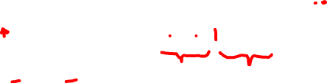
Word2Vec
Predict each neighboring word in a context window of 2C of surrounding words
So for C=2, we are given a word wt and we try to predict its 4 surrounding words
[wt-2, wt-1, wt+1, wt+2]
Uses "negative sampling" for training

Slide 89
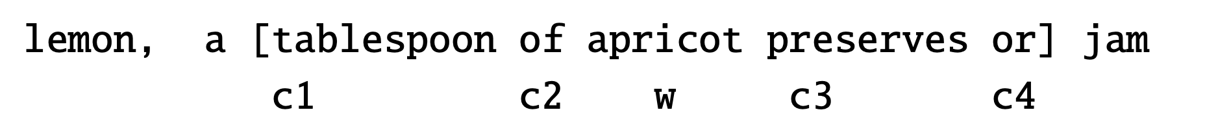

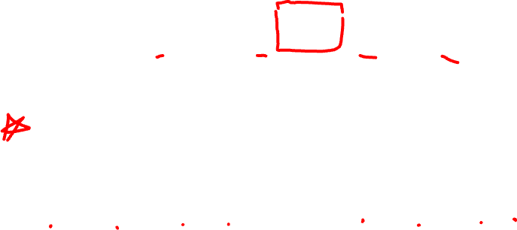
Negative sampling
We want predictions
of these words to be high
And these words to be low

Slide 90
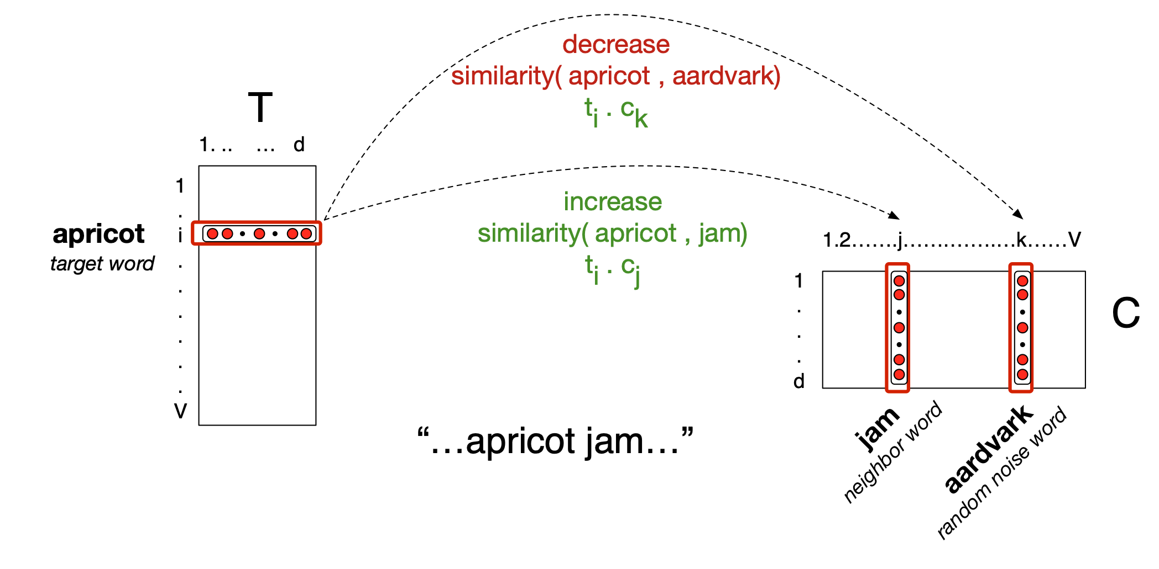
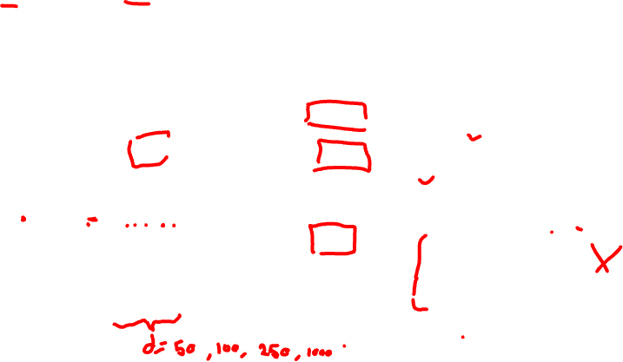
Logistic Regression Classifier

Slide 91
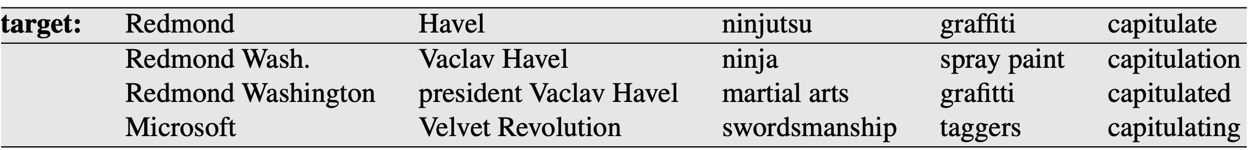
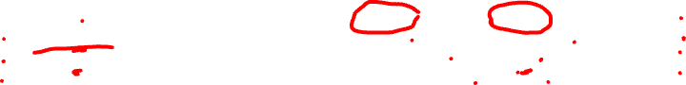
Properties of Embeddings
Nearest Neighbors are surprisingly good

Slide 92
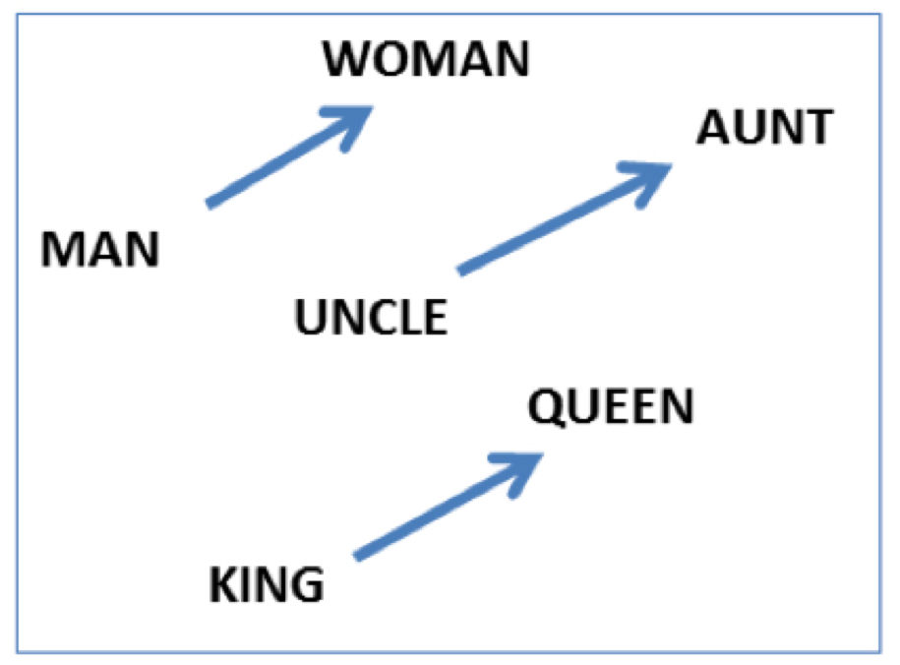
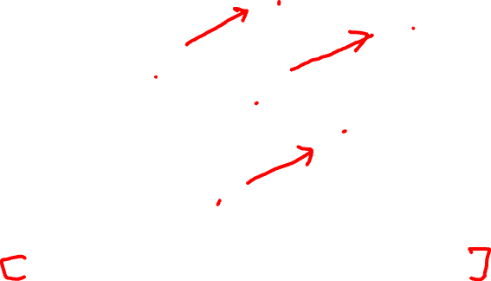
Embeddings capture relational meanings
vector('king') - vector('man') + vector('queen') ≅ vector('woman’)s

Slide 93
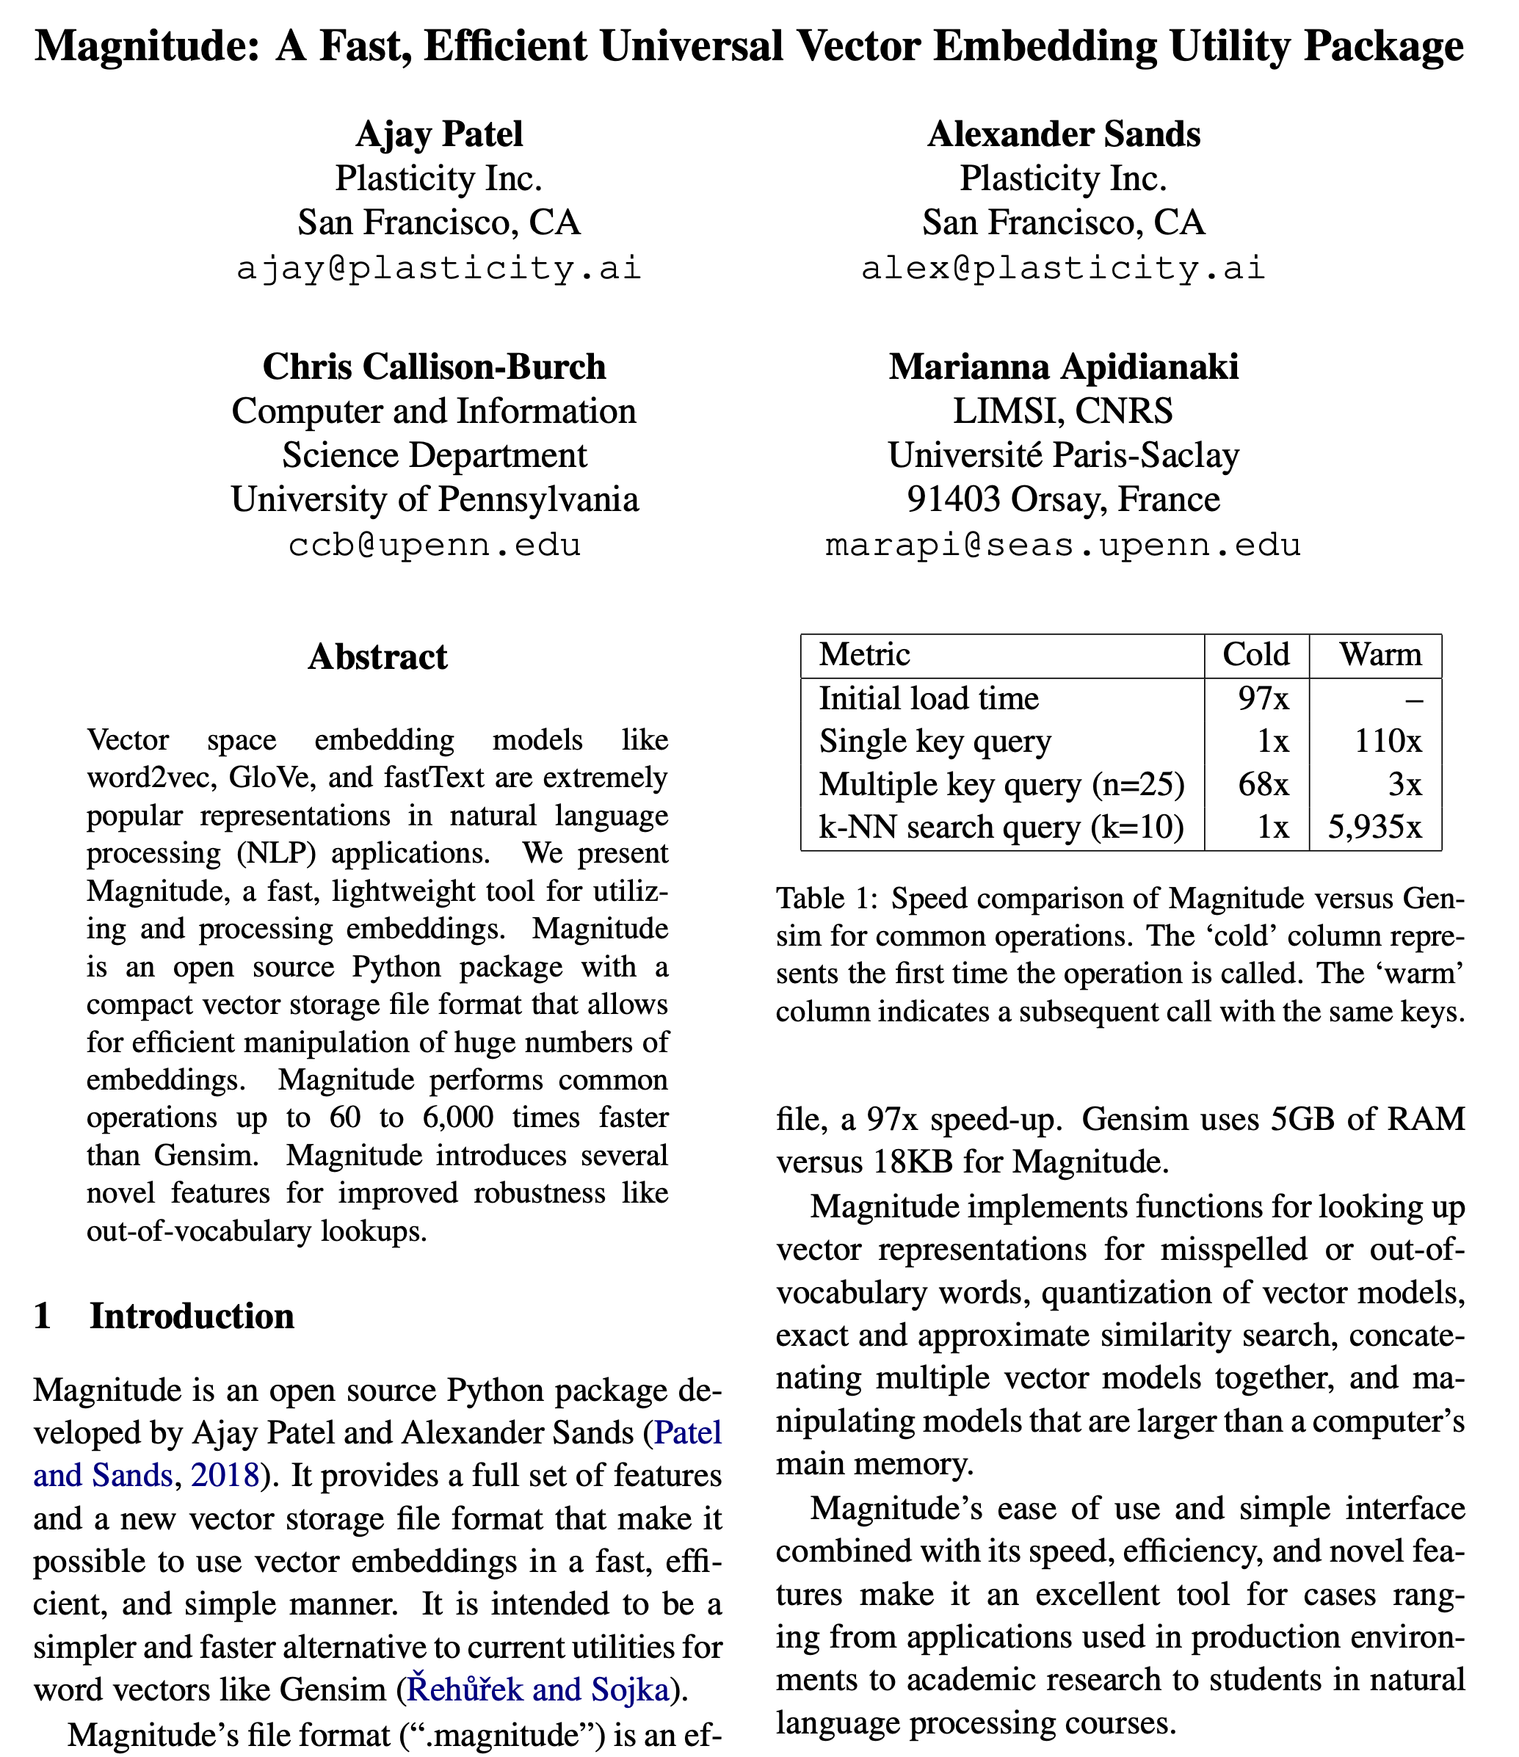

Slide 94
Demo of Word Vectors using Magnitude
Colab Notebook https://colab.research.google.com/drive/19iOTYgRn3bBAJIigHH8aK7ipYSYgy75x?usp=sharing

Slide 95
Demo of word vectors
from pymagnitude import *
vectors = Magnitude("GoogleNews-vectors-negative300.magnitude")
queen = vectors.query('queen')
king = vectors.query("king")
vectors.similarity(king, queen)
# 0.6510958
vectors.most_similar_approx(king, topn=5)
#[('king', 1.0), ('kings', 0.72), ('prince', 0.62), ('sultan', 0.59), ('ruler', 0.58)]

Slide 96
Many possible models
Matrix type
Term-document
Term-context
Pattern-pair
Reweighting
length norm.
TF-IDF
PPMI
probabilities
Comparisons
cosine
Manhattan
Jaccard
KL divergence
JS distance
DICE
Dim. Reduction
word2vec
GloVe
PCA
LDA
LSA
How many dimensions?
What modifications should we make to the input?
Notes:
Modifications: tokenization/normalization, annotation/tagger, parsing, cluster text by author/time/etc.

Slide 97
Evaluating embeddings
Compare to human scores on word similarity-type tasks:
WordSim-353 (Finkelstein et al., 2002)
SimLex-999 (Hill et al., 2015)
Stanford Contextual Word Similarity (SCWS) dataset (Huang et al., 2012)
TOEFL dataset: “levied” is closest in meaning to: (a) imposed, (b) believed, (c) requested, (d) correlated

Slide 98
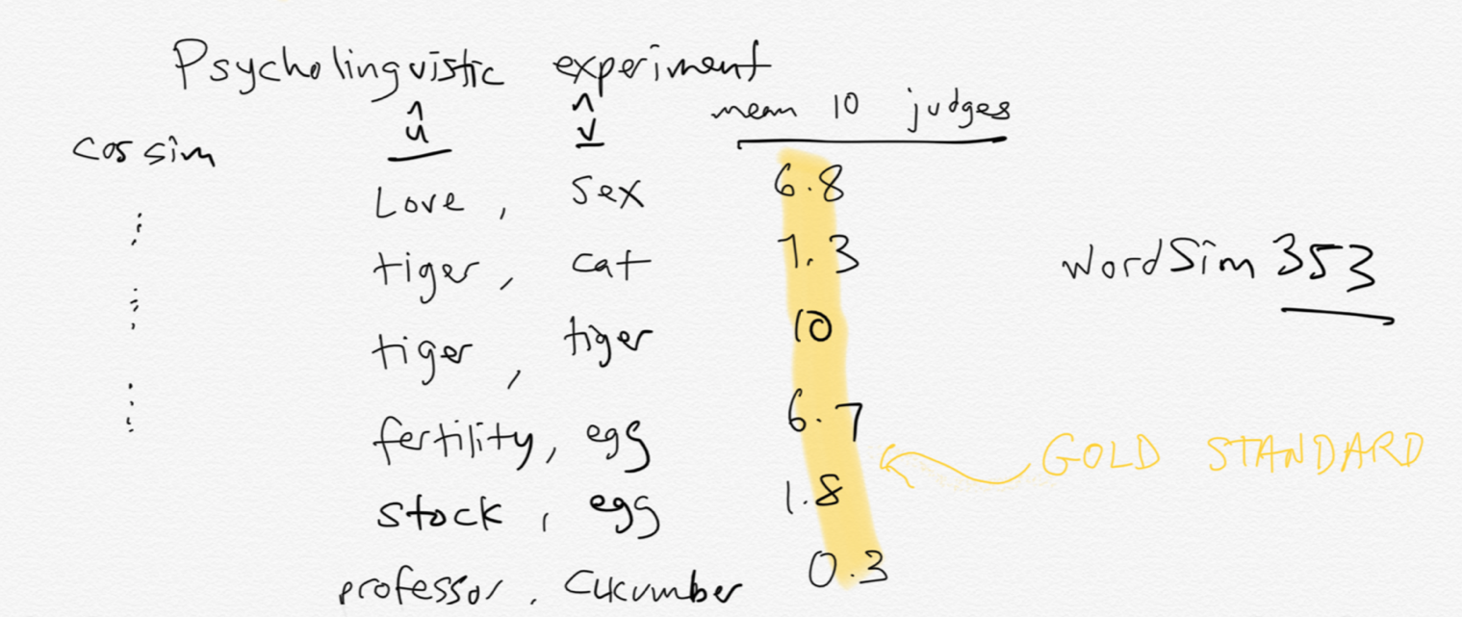
Intrinsic evaluation

Slide 99
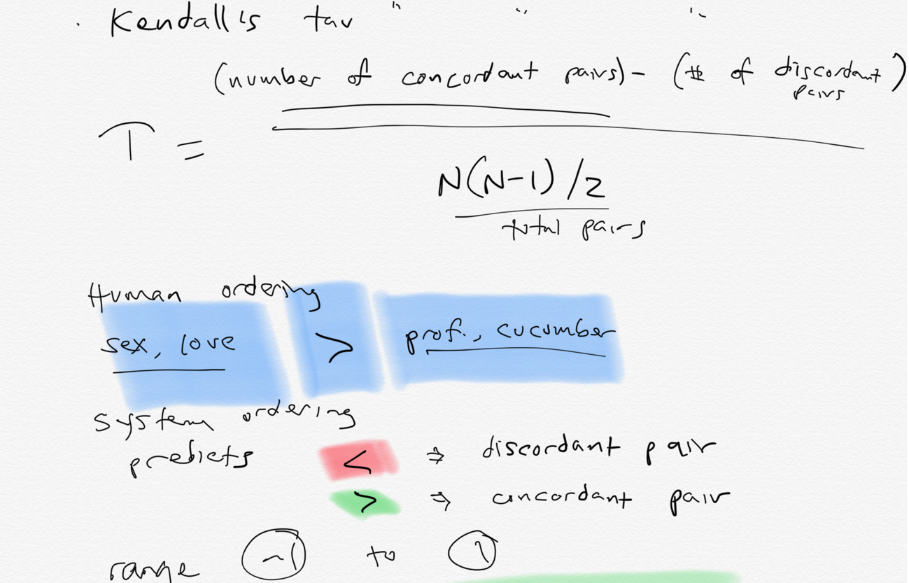
Compute correlation

Slide 100
Properties of embeddings
Similarity depends on window size C
C = ±2 The nearest words to Hogwarts:
Sunnydale
Evernight
C = ±5 The nearest words to Hogwarts:
Dumbledore
Malfoy
halfblood

Slide 101
How does context window change word emeddings?

Slide 102
How does context window change word emeddings?

Slide 103
Solving Analogy Problems

Slide 104
Solving analogies with embeddings
In a word-analogy task we are given two pairs of words that share a relation (e.g. “man:woman”, “king:queen”).
The identity of the fourth word (“queen”) is hidden, and we need to infer it based on the other three by answering
“man is to woman as king is to — ?”
More generally, we will say a:a∗ as b:b∗.
How can we solve these with word vectors?

Slide 105
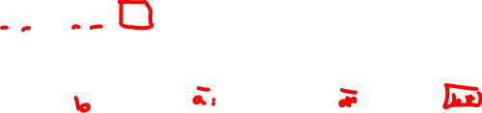
Vector Arithmetic
a:a∗ as b:b∗. b∗ is a hidden vector.
b∗ should be similar to the vector b − a + a∗
vector(‘king’) - vector(‘man’) + vector(‘woman’) $≈$vector(‘queen’)
king
queen
man
woman
Notes:
Analogy Another semantic property of embeddings is their ability to capture re- lational meanings. Mikolov et al. (2013b) and Levy and Goldberg (2014b) show that the offsets between vector embeddings can capture some analogical relations between words. For example, the result of the expression vector(‘king’) - vec- tor(‘man’) + vector(‘woman’) is a vector close to vector(‘queen’); the left panel in Fig. 6.14 visualizes this, again projected down into 2 dimensions. Similarly, they found that the expression vector(‘Paris’) - vector(‘France’) + vector(‘Italy’) results in a vector that is very close to vector(‘Rome’).

Slide 106
Vector Arithmetic
a:a∗ as b:b∗. b∗ is a hidden vector.
b∗ should be similar to the vector b − a + a∗
vector(‘king’) - vector(‘man’) + vector(‘woman’) $≈$vector(‘queen’)
king
queen
man
woman
Notes:
Analogy Another semantic property of embeddings is their ability to capture re- lational meanings. Mikolov et al. (2013b) and Levy and Goldberg (2014b) show that the offsets between vector embeddings can capture some analogical relations between words. For example, the result of the expression vector(‘king’) - vec- tor(‘man’) + vector(‘woman’) is a vector close to vector(‘queen’); the left panel in Fig. 6.14 visualizes this, again projected down into 2 dimensions. Similarly, they found that the expression vector(‘Paris’) - vector(‘France’) + vector(‘Italy’) results in a vector that is very close to vector(‘Rome’).

Slide 107
Analogy: Embeddings capture relational meaning!
a:a∗ as b:b∗. b∗ is a hidden vector.
b∗ should be similar to the vector b − a + a∗
vector(‘king’) - vector(‘man’) + vector(‘woman’) $≈$vector(‘queen’)
king
-man
+woman
queen
man
woman
Notes:
Analogy Another semantic property of embeddings is their ability to capture re- lational meanings. Mikolov et al. (2013b) and Levy and Goldberg (2014b) show that the offsets between vector embeddings can capture some analogical relations between words. For example, the result of the expression vector(‘king’) - vec- tor(‘man’) + vector(‘woman’) is a vector close to vector(‘queen’); the left panel in Fig. 6.14 visualizes this, again projected down into 2 dimensions. Similarly, they found that the expression vector(‘Paris’) - vector(‘France’) + vector(‘Italy’) results in a vector that is very close to vector(‘Rome’).

Slide 108

Vector Arithmetic
a:a∗ as b:b∗. b∗ is a hidden vector.
b∗ should be similar to the vector b − a + a∗
vector(‘king’) - vector(‘man’) + vector(‘woman’) $≈$vector(‘queen’)
king
-man
+woman
queen
man
woman
The analogy question can be solved by optimizing:
Notes:
Analogy Another semantic property of embeddings is their ability to capture re- lational meanings. Mikolov et al. (2013b) and Levy and Goldberg (2014b) show that the offsets between vector embeddings can capture some analogical relations between words. For example, the result of the expression vector(‘king’) - vec- tor(‘man’) + vector(‘woman’) is a vector close to vector(‘queen’); the left panel in Fig. 6.14 visualizes this, again projected down into 2 dimensions. Similarly, they found that the expression vector(‘Paris’) - vector(‘France’) + vector(‘Italy’) results in a vector that is very close to vector(‘Rome’).

Slide 109
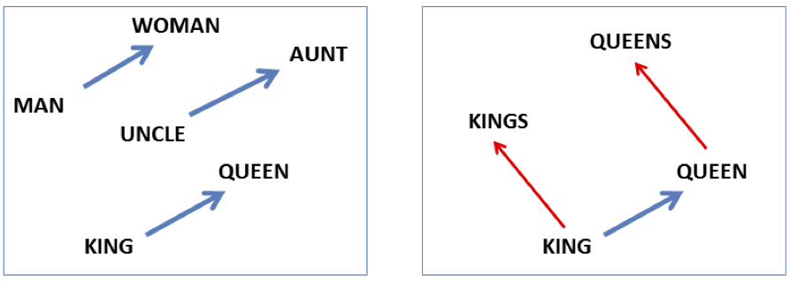
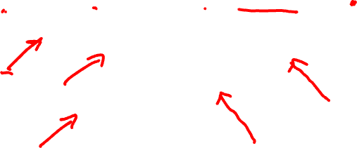
Analogy: Embeddings capture relational meaning!
vector(‘king’) - vector(‘man’) + vector(‘woman’) $≈$vector(‘queen’)
vector(‘Paris’) - vector(‘France’) + vector(‘Italy’) $≈$ vector(‘Rome’)
Notes:
Analogy Another semantic property of embeddings is their ability to capture relational meanings. Mikolov et al. (2013b) and Levy and Goldberg (2014b) show that the offsets between vector embeddings can capture some analogical relations between words. For example, the result of the expression vector(‘king’) - vec- tor(‘man’) + vector(‘woman’) is a vector close to vector(‘queen’); the left panel in Fig. 6.14 visualizes this, again projected down into 2 dimensions. Similarly, they found that the expression vector(‘Paris’) - vector(‘France’) + vector(‘Italy’) results in a vector that is very close to vector(‘Rome’).

Slide 110
Vector Arithmetic
If all word-vectors are normalized to unit length then
is equivalent to
Notes:
This means that solving analogy questions with vector arithmetic is mathematically equivalent to seeking a word (b∗) which is similar to b and a∗ but is different from a. Relational similarity is thus expressed as a sum of attributional similarities.
attributional similarities between vocabulary items means that words that appear in similar contexts will be close to each other in the projected space

Slide 111
Vector Arithmetic
Alternatively, we can require that the direction of the transformation be maintained.
This basically means that b∗ − b shares the same direction with a∗ − a, ignoring the distances
Notes:
Levy and Goldberg refer to this method as PAIRDIRECTION.
In this study, we show that similarly to the neural embedding space, the explicit vector space also encodes a vast amount of relational similar- ity which can be recovered in a similar fashion, suggesting the explicit vector space representation as a competitive baseline for further work on neu- ral embeddings

Slide 112
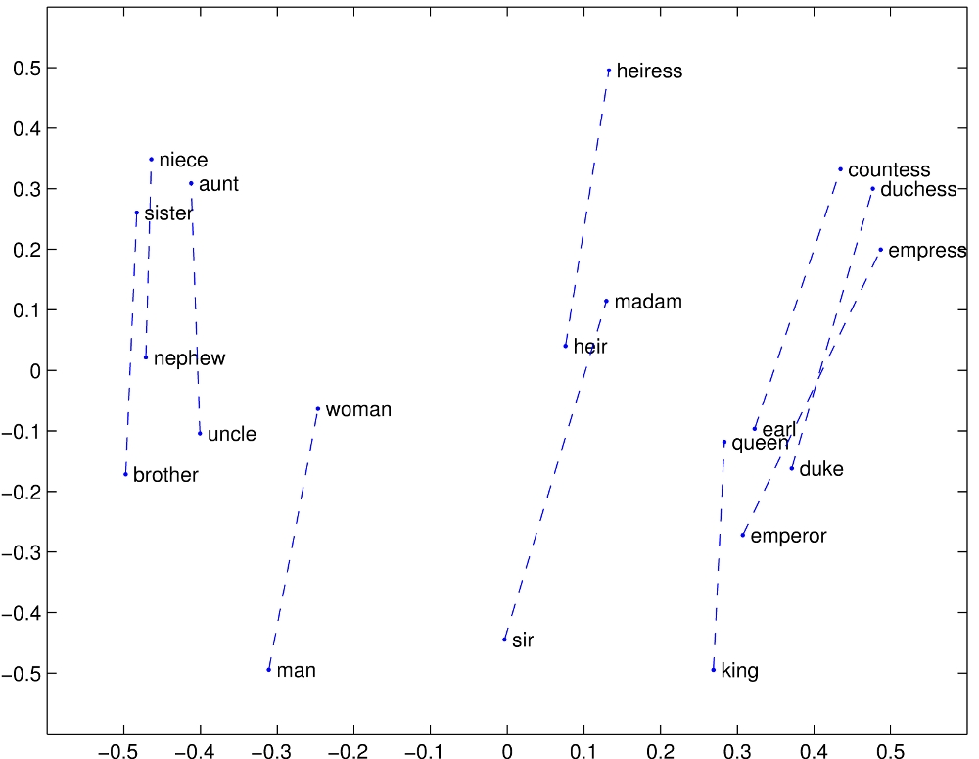

Notes:
Relational properties of the vector space, shown by projecting vectors onto two dimensions. (a) ’king’ - ’man’ + ’woman’ is close to ’queen’

Slide 113
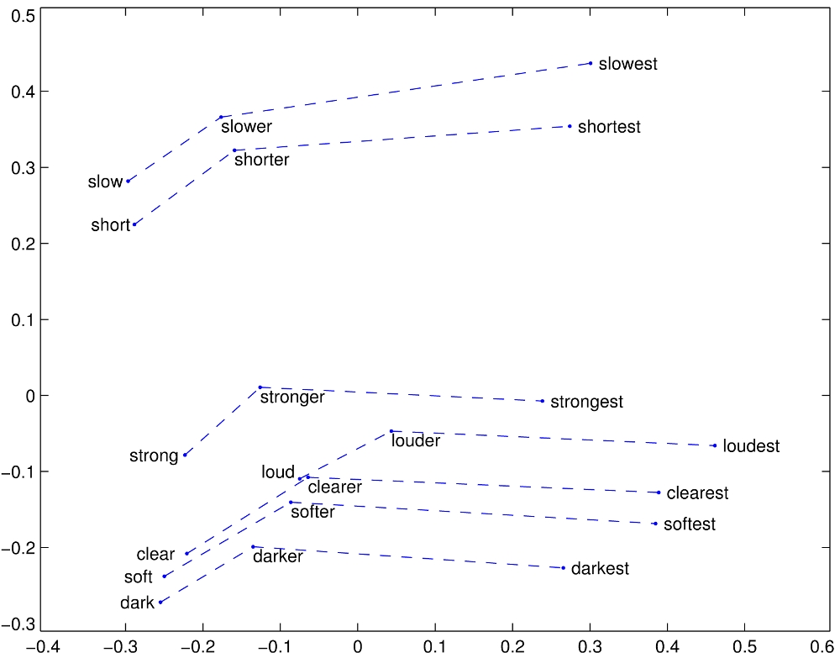
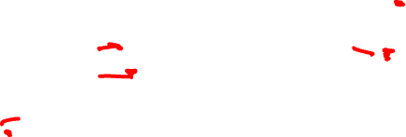
Notes:
Relational properties of the vector space,
offsets seem to capture comparative and superlative morphology (Pennington et al., 2014).

Slide 114
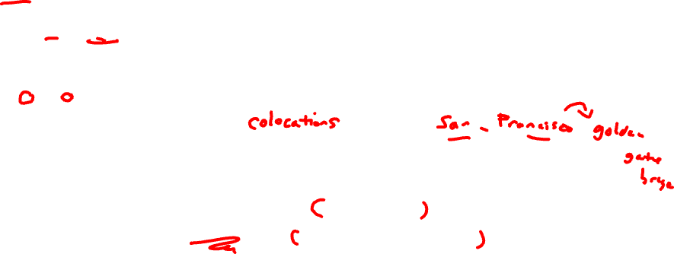
Representing Phrases with vectors
Mikolov et al constructed representations for phrases as well as for individual words.
To learn vector representations for phrases, they first find words that appear frequently together but infrequently in other contexts, and represent these n-grams as single tokens.
For example, “New York Times” and “Toronoto Maple Leafs” are replaced by New_York_Times and Toronoto_Maple_Leafs, but a bigram like “this is” remains unchanged.
Notes:
The δ is used as a discounting coefficient and prevents too many phrases consisting of very infre- quent words to be formed. The bigrams with score above the chosen threshold are then used as phrases. Typically, we run 2-4 passes over the training data with decreasing threshold value, allow- ing longer phrases that consists of several words to be formed.

Slide 115

Analogical reasoning task for phrases

Slide 116
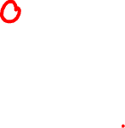
Vector compositionality
Mikolov et al experiment with using element-wise addition to compose vectors
Notes:
CCB – try some out in Magnitude

Slide 117
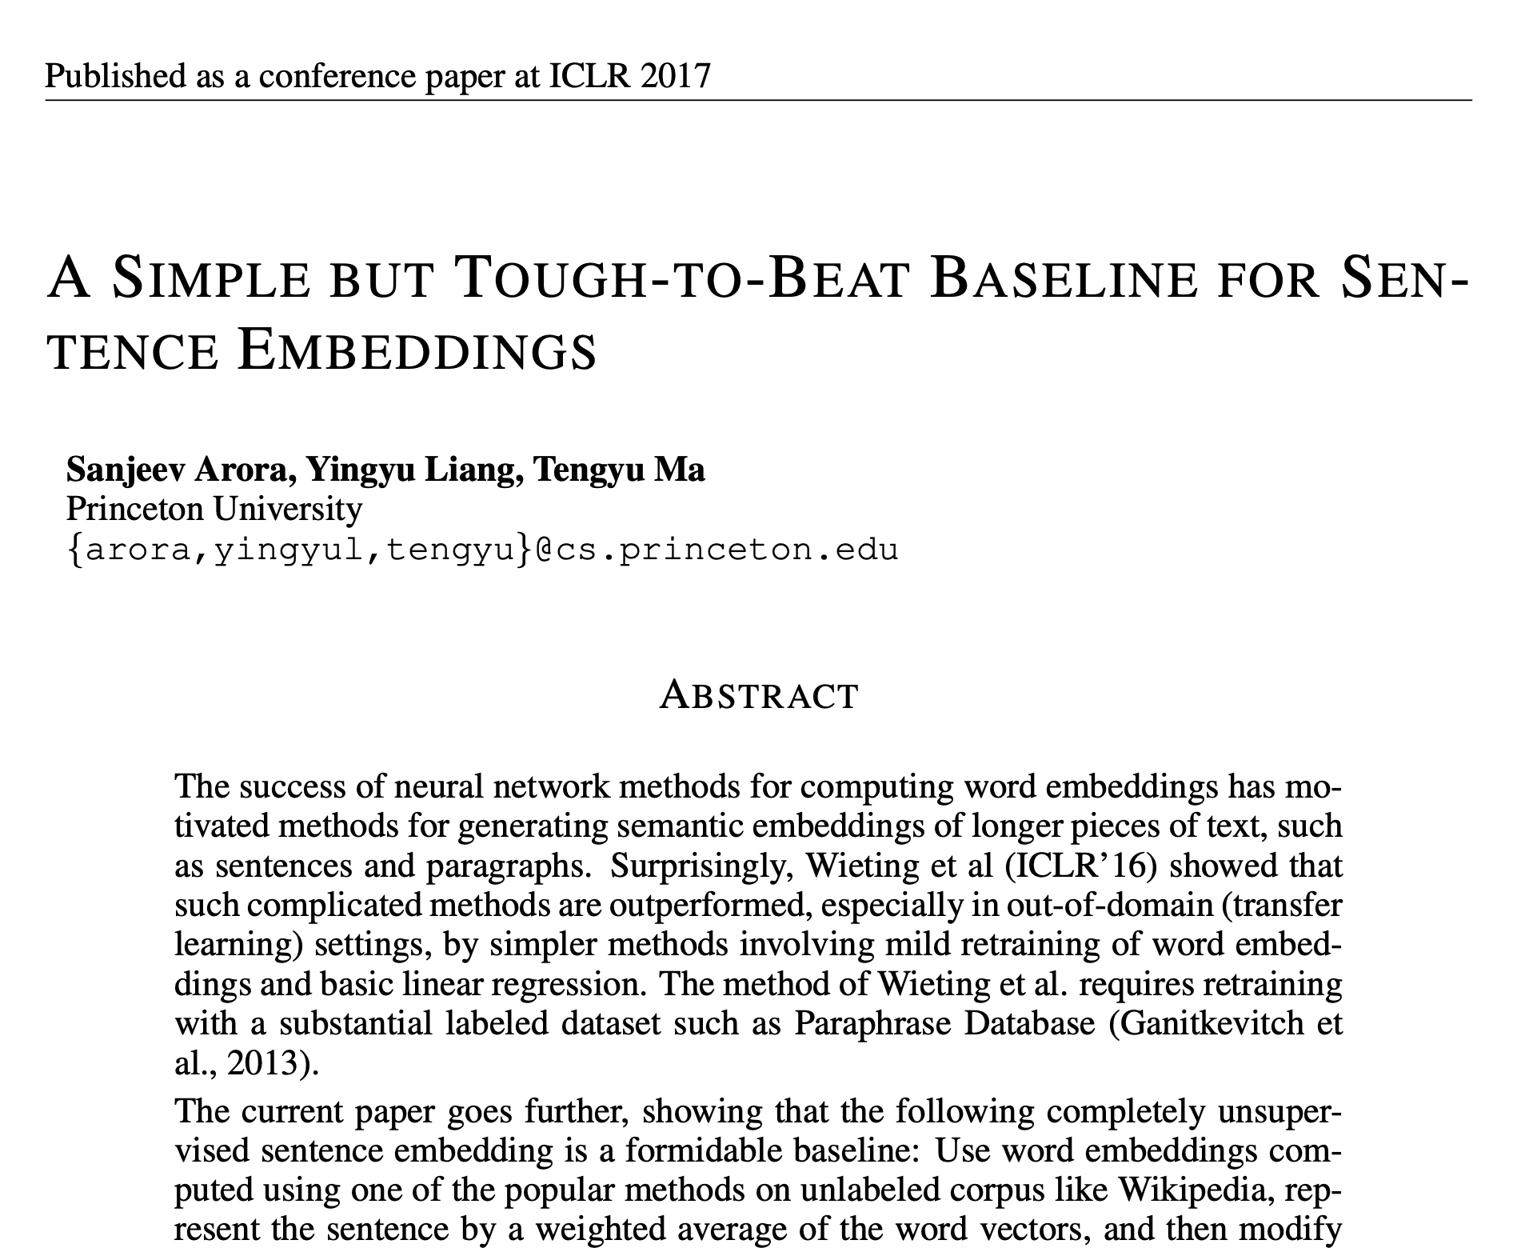

Slide 118
Word Embeddings for Sociology

Slide 119

Embeddings can help study word history!
Train embeddings on old books to study changes in word meaning!!
Dan Jurafsky
Will Hamilton
Notes:
Embeddings and Historical Semantics: Embeddings can also be a useful tool for studying how meaning changes over time, by computing multiple embedding spaces, each from texts written in a particular time period. For example Fig. 6.15 shows a visualization of changes in meaning in English words over the last two centuries, computed by building separate embedding spaces for each decade from historical corpora like Google N-grams (Lin et al., 2012) and the Corpus of Histori- cal American English (Davies, 2012).

Slide 120


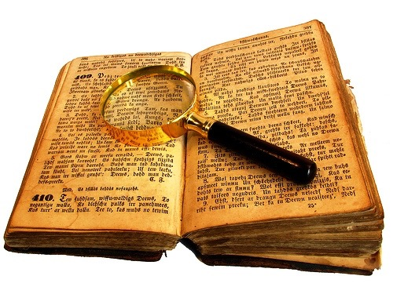
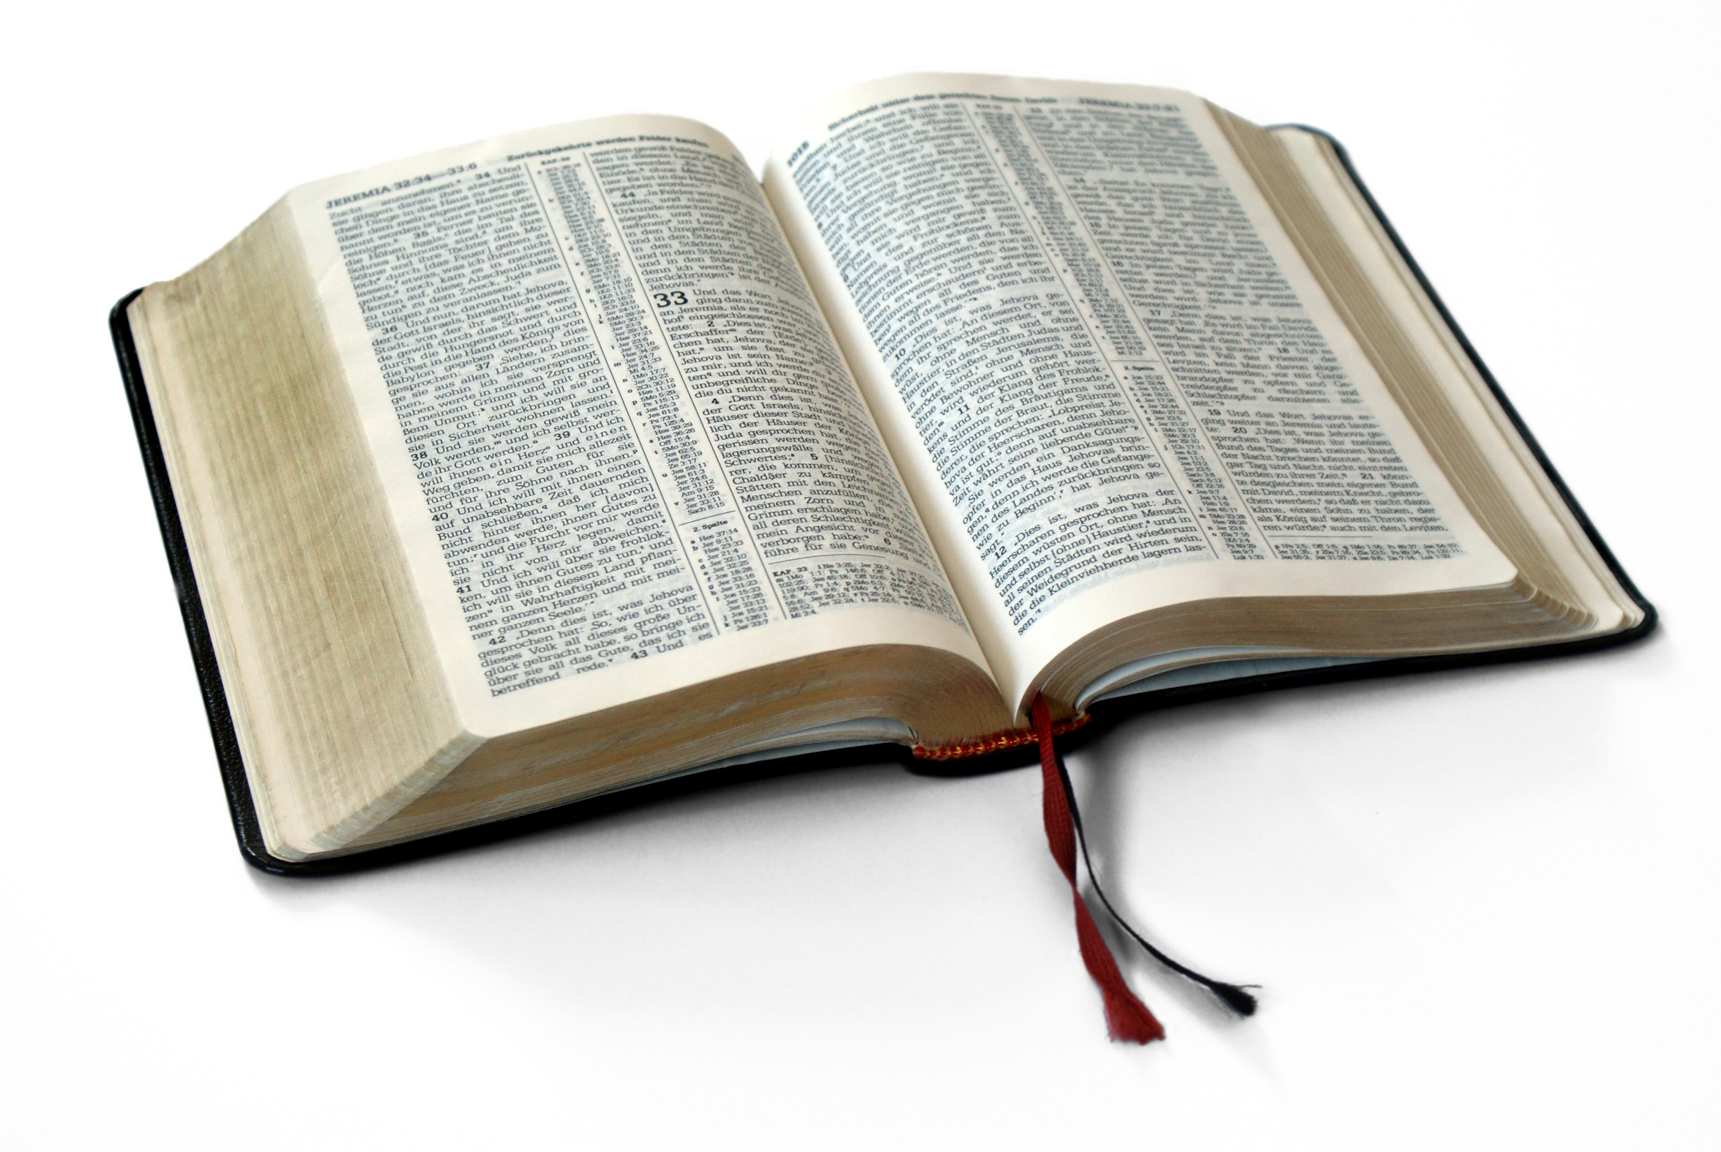
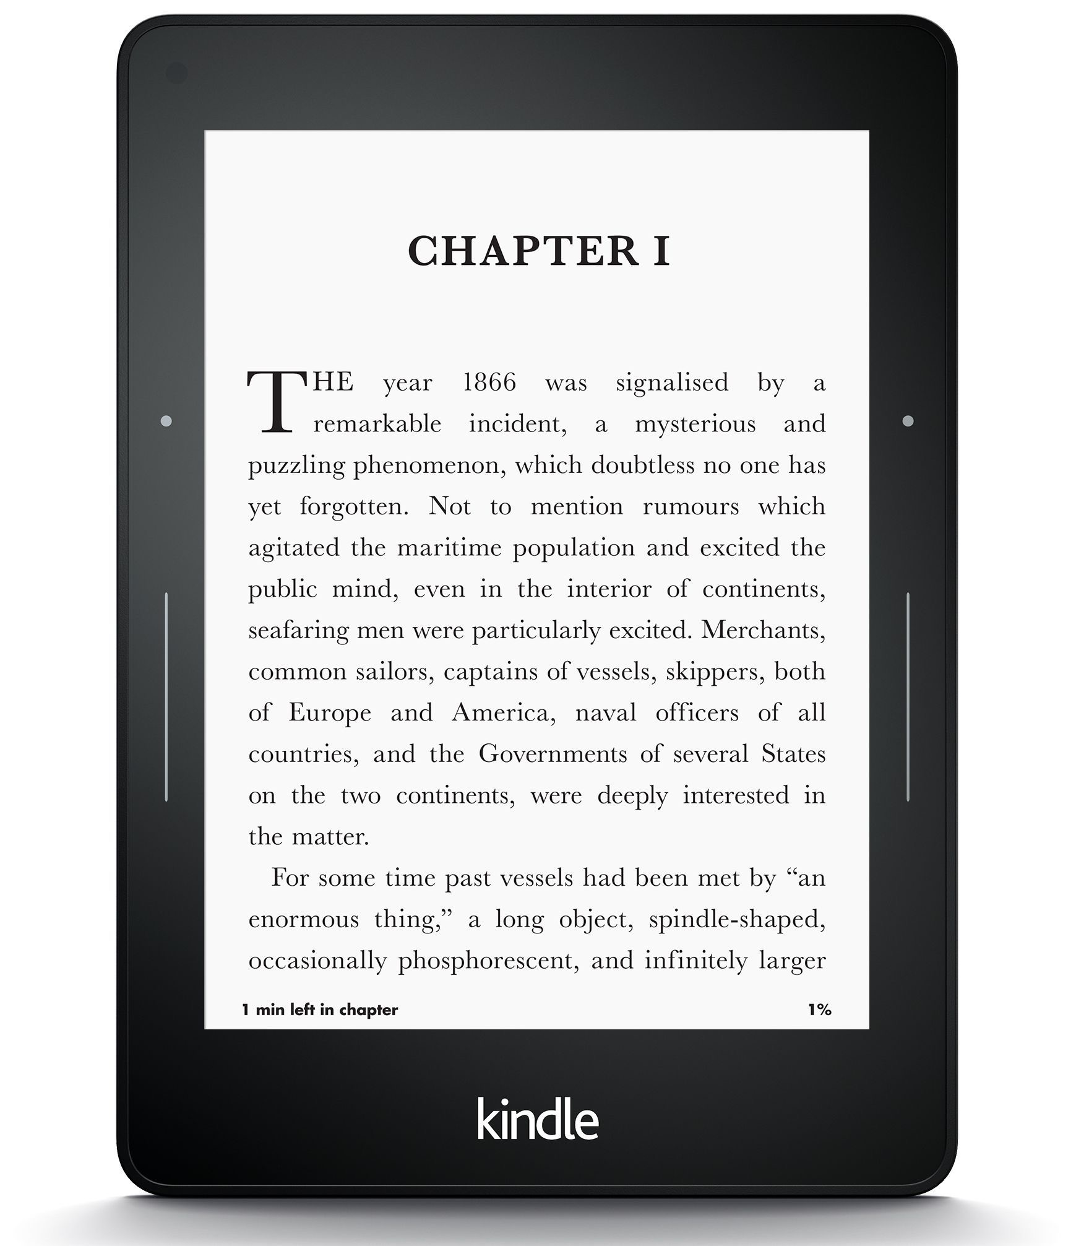
Diachronic word embeddings for studying language change!
Word vectors for 1920
Word vectors 1990
“dog” 1990 word vector
“dog” 1920 word vector
vs.
1900
1950
2000
￼
￼
Notes:
di·a·chron·ic | ˌdīəˈkränik |
adjective
concerned with the way in which something, especially language, has developed and evolved through time. linguistic change is the diachronic aspect of linguistic variation.

Slide 121
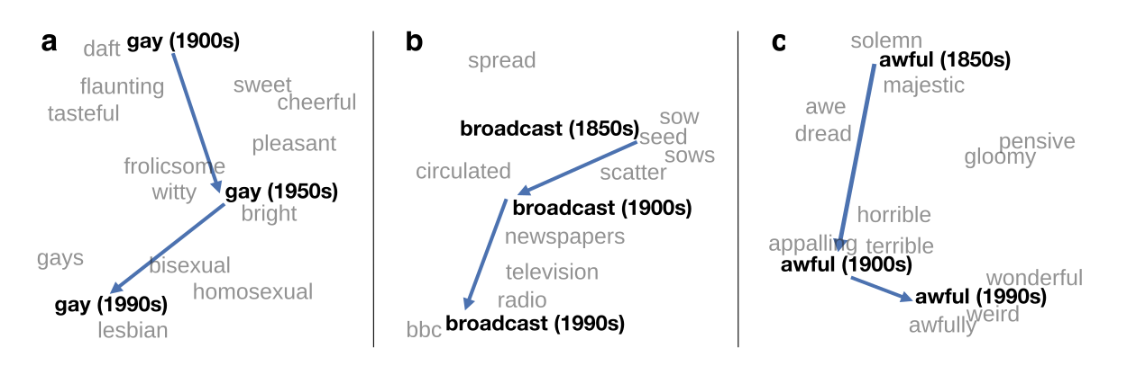
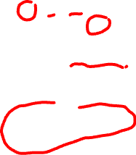
Visualizing changes
Project 300 dimensions down into 2
~30 million books, 1850-1990, Google Books data
Notes:
visualization of the semantic change of 3 words in English using
Figure 5à: Two-dimensional visualization of semantic change in English using SGNS word2vec vectors. The modern sense of each word, and the grey context words, are com-
vectors see Section 5à8 for the visualization algorithm à A, The word gay shifted puted from the most recent (modern) time-point embedding space. Earlier points are com-
from meaning ÒcheerfulÓ or ÒfrolicsomeÓ to referring to homosexualityà A, In the early puted from earlier historical embedding spaces. The visualizations show the changes in the
2àth century broadcast referred to Òcasting out seedsÓà with the rise of television and word gay from meanings related to “cheerful” or “frolicsome” to referring to homosexuality,
radio its meaning shifted to Òtransmitting signalsÓà C, Awful underwent a process of the development of the modern “transmission” sense of broadcast from its original sense of
pejoration, as it shifted from meaning Òfull of aweÓ to meaning Òterrible or appallingÓ
sowing seeds, and the pejoration of the word awful as it shifted from meaning “full of awe” t2om2eàaning “terrible or appalling”

Slide 122
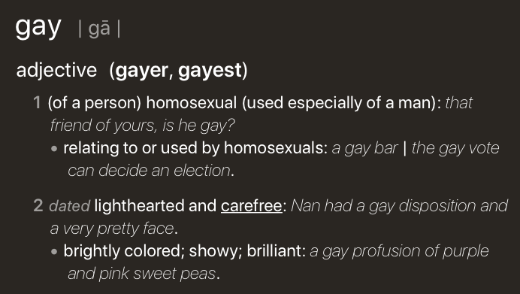
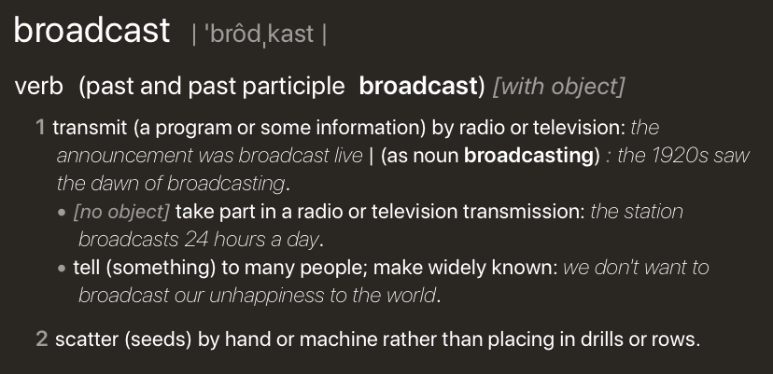
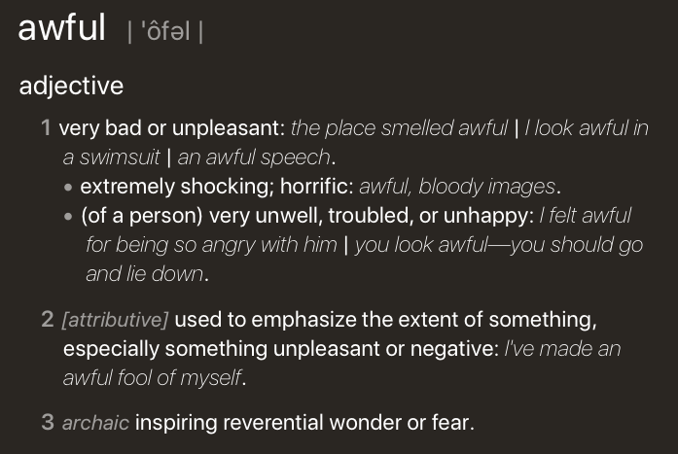
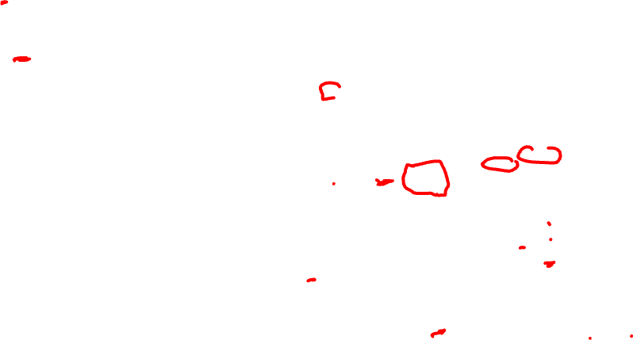
Visualizing changes
Project 300 dimensions down into 2
~30 million books, 1850-1990, Google Books data
Notes:
visualization of the semantic change of 3 words in English using
Figure 5à: Two-dimensional visualization of semantic change in English using SGNS word2vec vectors. The modern sense of each word, and the grey context words, are com-
vectors see Section 5à8 for the visualization algorithm à A, The word gay shifted puted from the most recent (modern) time-point embedding space. Earlier points are com-
from meaning ÒcheerfulÓ or ÒfrolicsomeÓ to referring to homosexualityà A, In the early puted from earlier historical embedding spaces. The visualizations show the changes in the
2àth century broadcast referred to Òcasting out seedsÓà with the rise of television and word gay from meanings related to “cheerful” or “frolicsome” to referring to homosexuality,
radio its meaning shifted to Òtransmitting signalsÓà C, Awful underwent a process of the development of the modern “transmission” sense of broadcast from its original sense of
pejoration, as it shifted from meaning Òfull of aweÓ to meaning Òterrible or appallingÓ
sowing seeds, and the pejoration of the word awful as it shifted from meaning “full of awe” t2om2eàaning “terrible or appalling”

Slide 123
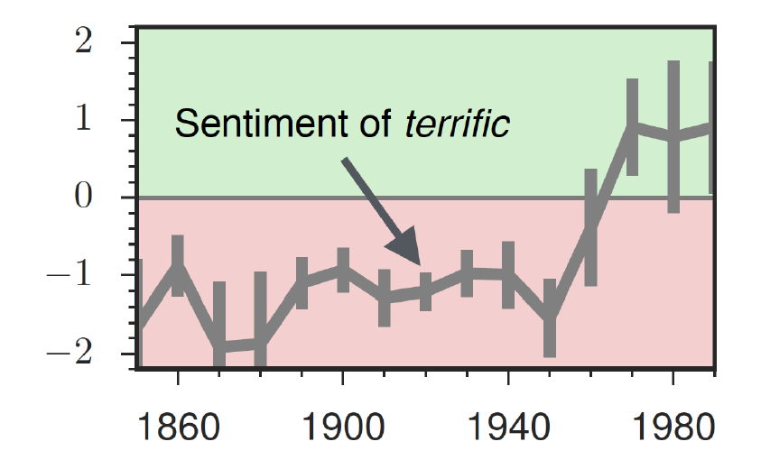
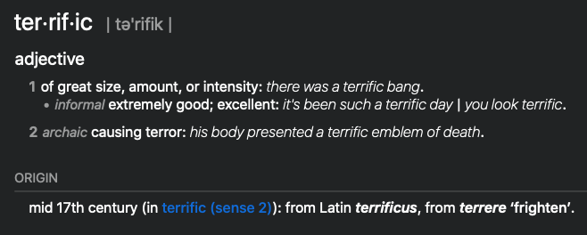
The evolution of sentiment words

Slide 124
Embeddings and bias
Notes:
In addition to their ability to learn word meaning from text, embeddings, alas, also
indicating surprise disbelief à
reproduce the implicit biases and stereotypes that were latent in the text. Recall that
embeddings model analogical relations; ‘queen’ as the closest word to ’king’ - ’man’
+ ’woman’ implies the analogy man:woman::king:queen. But embedding analogies 5à2à2 Computational linguistic studies
also exhibit gender stereotypes.

Slide 125
Embeddings reflect cultural bias
Ask “Paris : France :: Tokyo : x”
x = Japan
Ask “father : doctor :: mother : x”
x = nurse
Ask “man : computer programmer :: woman : x”
x = homemaker
Bolukbasi, Tolga, Kai-Wei Chang, James Y. Zou, Venkatesh Saligrama, and Adam T. Kalai. "Man is to computer programmer as woman is to homemaker? debiasing word embeddings." In Advances in Neural Information Processing Systems, pp. 4349-4357. 2016.
Notes:
For example Bolukbasi et al. (2016) find that the closest occupation to ‘man’ - ‘computer programmer’ + ‘woman’ in word2vec em-
There are also a number of recent works analyzing semantic change using computational
beddings trained on news text is ‘homemaker’, and that the embeddings similarly
methodsà 2àà use latent semantic analysis to analyze how word meanings broaden
suggest the analogy ‘father’ is to ‘doctor’ as ‘mother’ is to ‘nurse’. Algorithms that
and narrow over timeà 3 use raw co-occurrence vectors to perform a number of
used embeddings as part of an algorithm to search for potential programmers or
historical case-studies on semantic change, and 252 perform a similar set of small-
doctors might thus incorrectly downweight documents with women’s names.

Slide 126

Measuring cultural bias
Implicit Association test (Greenwald et al 1998): How associated are
concepts (flowers, insects) & attributes (pleasantness, unpleasantness)?
Studied by measuring timing latencies for categorization.
Psychological findings on US participants:
African-American names are associated with unpleasant words (more than European-American names)
Male names associated more with math, female names with arts
Old people's names with unpleasant words, young people with pleasant words.
Notes:
Roughly speaking, if humans associate ‘flowers’ with ’pleasantness’ and ‘insects’ with ‘unpleasant- ness’, when they are instructed to push a red button for ‘flowers’ (daisy, iris, lilac) and ’pleasant words’ (love, laughter, pleasure) and a green button for ‘insects’ (flea, spider, mosquito) and ‘unpleasant words’ (abuse, hatred, ugly) they are faster than in an incongruous condition where they push a red button for ‘flowers’ and ‘unpleasant words’ and a green button for ‘insects’ and ‘pleasant words
Embeddings also encode the implicit associations that are a property of human
scale case-studies using temporal topic modelsà 8à construct point-wise mutual
reasoning. The Implicit Association Test (Greenwald et al., 1998) measures peo- information-based embeddings and found that semantic changes uncovered by their
ple’s associations between concepts (like ’flowers’ or ’insects’) and attributes (like
method had reasonable agreement with human judgmentsà 29 and 9 use ÒneuralÓ
‘pleasantness’ and ‘unpleasantness’) by measuring differences in the latency with
word-embedding methods to detect linguistic change pointsà Finally, 25à analyze
which they label words in the various categories.6 Using such methods, people in the United States have been shown to associate African-American names with
historical co-occurrences to test whether synonyms tend to change in similar waysà
unpleasant words (more than European-American names), male names more with mathematics and female names with the arts, and old people’s names with unpleas- ant words (Greenwald et al. 1998, Nosek et al. 2002a, Nosek et al. 2002b). Caliskan et al. (2017) replicated all these findings of implicit associations using GloVe vec- tors and cosine similarity instead of human latencies. For example Afrian American names like ‘Leroy’ and ‘Shaniqua’ had a higher GloVe cosine with unpleasant words while European American names (‘Brad’, ‘Greg’, ‘Courtney’) had a higher cosine with pleasant words. Any embedding-aware algorithm that made use of word senti- ment could thus lead to bias against African Americans.

Slide 127
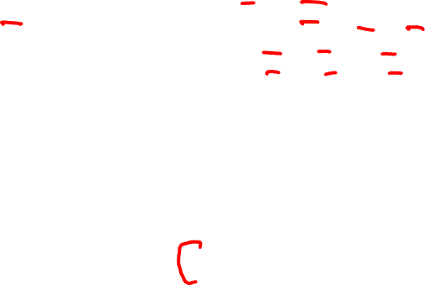
Embeddings reflect cultural bias
Caliskan et al. replication with embeddings:
African-American names (Leroy, Shaniqua) had a higher GloVe cosine with unpleasant words (abuse, stink, ugly)
European American names (Brad, Greg, Courtney) had a higher cosine with pleasant words (love, peace, miracle)
Embeddings reflect and replicate all sorts of pernicious biases.
Aylin Caliskan, Joanna J. Bruson and Arvind Narayanan. 2017. Semantics derived automatically from language corpora contain human-like biases. Science 356:6334, 183-186.
Notes:
Roughly speaking, if humans associate ‘flowers’ with ’pleasantness’ and ‘insects’ with ‘unpleasant- ness’, when they are instructed to push a red button for ‘flowers’ (daisy, iris, lilac) and ’pleasant words’ (love, laughter, pleasure) and a green button for ‘insects’ (flea, spider, mosquito) and ‘unpleasant words’ (abuse, hatred, ugly) they are faster than in an incongruous condition where they push a red button for ‘flowers’ and ‘unpleasant words’ and a green button for ‘insects’ and ‘pleasant words
Embeddings also encode the implicit associations that are a property of human
scale case-studies using temporal topic modelsà 8à construct point-wise mutual
reasoning. The Implicit Association Test (Greenwald et al., 1998) measures peo- information-based embeddings and found that semantic changes uncovered by their
ple’s associations between concepts (like ’flowers’ or ’insects’) and attributes (like
method had reasonable agreement with human judgmentsà 29 and 9 use ÒneuralÓ
‘pleasantness’ and ‘unpleasantness’) by measuring differences in the latency with
word-embedding methods to detect linguistic change pointsà Finally, 25à analyze
which they label words in the various categories.6 Using such methods, people in the United States have been shown to associate African-American names with
historical co-occurrences to test whether synonyms tend to change in similar waysà
unpleasant words (more than European-American names), male names more with mathematics and female names with the arts, and old people’s names with unpleas- ant words (Greenwald et al. 1998, Nosek et al. 2002a, Nosek et al. 2002b). Caliskan et al. (2017) replicated all these findings of implicit associations using GloVe vec- tors and cosine similarity instead of human latencies. For example Afrian American names like ‘Leroy’ and ‘Shaniqua’ had a higher GloVe cosine with unpleasant words while European American names (‘Brad’, ‘Greg’, ‘Courtney’) had a higher cosine with pleasant words. Any embedding-aware algorithm that made use of word senti- ment could thus lead to bias against African Americans.

Slide 128
Directions
Debiasing algorithms for embeddings
Use embeddings as a tool to study historical bias

Slide 129
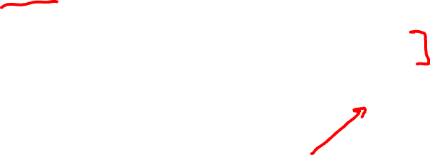
Embeddings as a window onto history
Use the Hamilton historical embeddings
The cosine similarity of embeddings for decade X for occupations (like teacher) to male vs female names
Is correlated with the actual percentage of women teachers in decade X
Nikhil Garg, Londa Schiebinger, Dan Jurafsky, and James Zou, (2018). Word embeddings quantify 100 years of gender and ethnic stereotypes. Proceedings of the National Academy of Sciences, 115(16), E3635–E3644

Slide 130

History of biased framings of women
Embeddings for competence adjectives are biased toward men
Smart, wise, brilliant, intelligent, resourceful, thoughtful, logical, etc.
This bias is slowly decreasing
Nikhil Garg, Londa Schiebinger, Dan Jurafsky, and James Zou, (2018). Word embeddings quantify 100 years of gender and ethnic stereotypes. Proceedings of the National Academy of Sciences, 115(16), E3635–E3644

Slide 131

Princeton Trilogy experiments
Study 1: Katz and Braley (1933)
Investigated whether traditional social stereotypes had a cultural basis
Ask 100 male students from Princeton University to choose five traits that characterized different ethnic groups (for example Americans, Jews, Japanese, Negroes) from a list of 84 word
84% of the students said that Negroes were superstitious and 79% said that Jews were shrewd. They were positive towards their own group.
Study 2: Gilbert (1951) Less uniformity of agreement about unfavorable traits than in 1933.
Study 3: Karlins et al. (1969)
Many students objected to the task but this time there was greater agreement on the stereotypes assigned to the different groups compared with the 1951 study. Interpreted as a re-emergence of social stereotyping but in the direction more favorable stereotypical images.
Notes:
Study 1: Katz and Braley (1933)
Investigated whether traditional social stereotypes had a cultural basis by asking 100 male students from Princeton University to choose five traits that characterized different ethnic groups (for example Americans, Jews, Japanese, Negroes) from a list of 84 words. The results showed considerable agreement in stereotypes, especially of negative traits. Eighty-four per cent of the students said that Negroes were superstitious and 79% said that Jews were shrewd. They were very positive towards their own group (ingroup bias). Since most of the students did not have any personal contact with members of the ethnic groups they had to rate, it was suggested that stereotypes are learned (e.g. through the media or by gatekeepers, i.e. they are cultural products).
Study 2: Gilbert (1951)
Replicated the study of Princeton students. This time there was less uniformity of agreement, especially about unfavorable traits, than in the 1933 study. The stereotypes still demonstrated an ingroup bias. Stereotypes about Japanese were extremely negative and this was explained by the negative press about Japan after Pearl Harbor, so the original hypothesis about stereotypes as cultural products was confirmed. Many students expressed irritation at being asked to make generalizations at all and this could indicate a social change (e.g. that it was no longer as acceptable to express stereotypes openly).
Study 3: Karlins et al. (1969)
Replicated the study. Many students objected to the task but this time there was greater agreement on the stereotypes assigned to the different groups compared with the 1951 study. The researchers interpreted this as a re-emergence of social stereotyping but in the direction of a more favorable stereotypical image.

Slide 132

Embeddings reflect ethnic stereotypes over time
Princeton trilogy experiments
Attitudes toward ethnic groups (1933, 1951, 1969) scores for adjectives
industrious, superstitious, nationalistic, etc
Cosine of Chinese name embeddings with those adjective embeddings correlates with human ratings.
Nikhil Garg, Londa Schiebinger, Dan Jurafsky, and James Zou, (2018). Word embeddings quantify 100 years of gender and ethnic stereotypes. Proceedings of the National Academy of Sciences, 115(16), E3635–E3644
Notes:
Study 1: Katz and Braley (1933)
Investigated whether traditional social stereotypes had a cultural basis by asking 100 male students from Princeton University to choose five traits that characterized different ethnic groups (for example Americans, Jews, Japanese, Negroes) from a list of 84 words. The results showed considerable agreement in stereotypes, especially of negative traits. Eighty-four per cent of the students said that Negroes were superstitious and 79% said that Jews were shrewd. They were very positive towards their own group (ingroup bias). Since most of the students did not have any personal contact with members of the ethnic groups they had to rate, it was suggested that stereotypes are learned (e.g. through the media or by gatekeepers, i.e. they are cultural products).
Study 2: Gilbert (1951)
Replicated the study of Princeton students. This time there was less uniformity of agreement, especially about unfavorable traits, than in the 1933 study. The stereotypes still demonstrated an ingroup bias. Stereotypes about Japanese were extremely negative and this was explained by the negative press about Japan after Pearl Harbor, so the original hypothesis about stereotypes as cultural products was confirmed. Many students expressed irritation at being asked to make generalizations at all and this could indicate a social change (e.g. that it was no longer as acceptable to express stereotypes openly).
Study 3: Karlins et al. (1969)
Replicated the study. Many students objected to the task but this time there was greater agreement on the stereotypes assigned to the different groups compared with the 1951 study. The researchers interpreted this as a re-emergence of social stereotyping but in the direction of a more favorable stereotypical image.

Slide 133

Change in linguistic framing 1910-1990
Change in association of Chinese names with adjectives framed as "othering" (barbaric, monstrous, bizarre)
Notes:
This shows the relative strength of the Asian association for words used to describe outsiders over time. As opposed to the adjectives overall, which see two distinct phase shifts in Asian association, the words related to outsiders steadily decrease in Asian association over time—except around World War II—indicating that broader globalization trends led to changing attitudes with regard to such negative portrayals. Overall, the word embeddings exhibit a remarkable change in adjectives and attitudes toward Asian Americans during the 20th century.

Slide 134

Changes in framing: adjectives associated with Chinese
Nikhil Garg, Londa Schiebinger, Dan Jurafsky, and James Zou, (2018). Word embeddings quantify 100 years of gender and ethnic stereotypes. Proceedings of the National Academy of Sciences, 115(16), E3635–E3644

Slide 135
Conclusion
Embeddings = vector models of meaning
More fine-grained than just a string or index
Especially good at modeling similarity/analogy
Just download them and use cosines!!
Can use sparse models (tf-idf) or dense models (word2vec, GLoVE)
Useful in practice but know they encode cultural stereotypes

Slide 136
Potential for Harm

Slide 137



It took less than 24 hours for Twitter to corrupt an innocent AI chatbot. Yesterday, Microsoft unveiled Tay — a Twitter bot that the company described as an experiment in "conversational understanding." The more you chat with Tay, said Microsoft, the smarter it gets, learning to engage people through "casual and playful conversation.”
Unfortunately, the conversations didn't stay playful for long. Pretty soon after Tay launched, people starting tweeting the bot with all sorts of misogynistic, racist, and Donald Trumpist remarks. And Tay — being essentially a robot parrot with an internet connection — started repeating these sentiments back to users, proving correct that old programming adage: flaming garbage pile in, flaming garbage pile out.
Notes:
https://www.theverge.com/2016/3/24/11297050/tay-microsoft-chatbot-racist

Slide 138


Slide 139


Slide 140


Slide 141


Slide 142


Slide 143




OpenAI’s researchers are sufficiently worried by something they built that they won’t release it to the public. The AI system that gave its creators pause was designed to learn the patterns of language. When OpenAI’s researchers configured the system to generate text, they began to think about their achievement differently.
“It looks pretty darn real,” says David Luan, vice president of engineering at OpenAI, of the text the system generates. He and his fellow researchers began to imagine how it might be used for unfriendly purposes. “It could be that someone who has malicious intent would be able to generate high-quality fake news,” Luan says.
That concern prompted OpenAI to publish a research paper on its results, but not release the full model or the 8 million web pages it used to train the system. Previously, the institute has often disseminated full code with its publications, including an earlier version of the language project from last summer.
OpenAI’s hesitation comes amid growing concern about the ethical implications of progress in AI, including from tech companies and lawmakers.
Notes:
https://www.wired.com/story/ai-text-generator-too-dangerous-to-make-public/

Slide 144

OpenAI let WIRED play with its text generator. It didn’t take much to get the system to unspool paragraphs that resembled the work of disinformation artists. When WIRED typed in the phrase “Hillary Clinton and George Soros” OpenAI’s system wrote the following:
“...are a perfect match, and their agenda appears to be to create a political movement where Soros and his political machine and Clinton are two of the only major players. This is the first time Soros and Clinton have been caught on tape directly colluding in promoting the same false narrative. One of the key revelations in the leaked audio was Clinton's admission to a Russian banker that she knew about the Uranium One deal before it was approved by Congress. Clinton was shown sharing the same talking points that were originally drafted by a Fusion GPS contractor hired by an anti-Trump Republican donor. The leaked audio is the clearest evidence yet that the Clinton campaign and the Hillary Foundation colluded with Fusion GPS to manufacture propaganda against President Trump.”

Slide 145

Notes:
https://beta.openai.com/docs/usage-policies/content-policy

Slide 146


Notes:
https://beta.openai.com/docs/usage-policies/content-policy

Slide 147


Notes:
https://openai.com/blog/improving-language-model-behavior/

Slide 148



Slide 149


Slide 150


Slide 151




Slide 152

Other potential harms
Spreading Misinformation
Spear Phishing
Impersonation / Deep Fakes
Next Generation of Plagiarism
Copyright Violations

Slide 153
Our Responsibilities
As developers and users of this technology, we need to be aware of its potential for harm, and actively take steps to mitigate its harms.
There is not a single solution mitigating harms.
We need to develop best practices, make policy recommendations, and make sure that ethics in AI is not an afterthought.

Slide 154
The End… But Not the End of Learning
CIS 4190/5190 – Applied Machine Learning
CIS 5200 – Machine Learning
CIS 5220 – Deep Learning
CIS 5300 – Computational Linguistics

Slide 155
Thank you!
Thanks for taking CIS 5210 with me!
Good luck on the midterm!!

